Slide 1
KWA-ZULU NATAL PROVINCIAL PRESENTATION
26 MARCH 2020 TO 19 MAY 2020

Slide 2
INDEX
INTRODUCTION
INVESTIGATION COMPONENT REPORT
Resources
COVID – 19 INVESTIGATION
Sec 28(1) B Death as result of Police Actions
Post Mortems
Gender Base Violence
Witnesses
CONCLUSION

Slide 3
INTRODUCTION
The Presentation is with regards to KZN Provincial Performance on Investigations on cases received during the Covid-19 Lockdown (Level 5 and Level 4).

Slide 4
RESOURCES
INVESTIGATING OFFICERS : 17
VEHICLES : 9 (6 ACTIVE)
(3 Vehicles in active due to services and mechanical issues.)
IPID Offices : 1 (Durban)

Slide 5
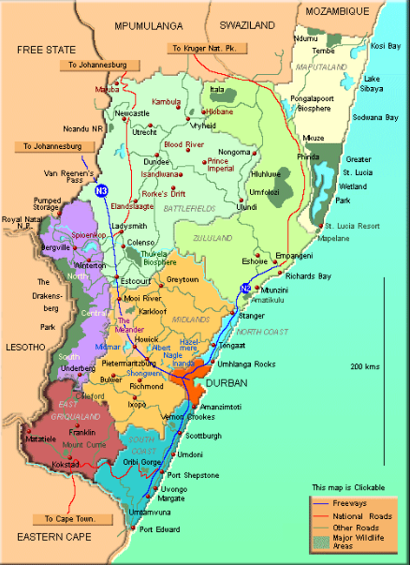
THIS MAP DEPICTS THE AREA THAT COVERS THE JURISDICTION OF IPID:
KWAZULU NATAL PROVISIONAL OFFICE
Capital : Pietermaritzburg
Population: 10.3 mil (21% of the South African population) Land Area : 94,361 km² (8% of the land area)
Police Stations and units: 214 SAPS Members: 24 155 Metro Police Departments: 1 Metro Police: 2538

Slide 6
NEWS WORTHY CASES
ISIPINGO CAS 97/04/2020 CCN 2020040097
FOLWENI CAS 16/05/2020 CCN 2020040097
INANDA CAS 359/04/2020 CCN 2020040609

Slide 7
COMPARISON OF STATS MARCH/ APRIL/ MAY 2019 TO MARCH/ APRIL/ MAY 2020
 | MARCH 2019 | MARCH 2020 | INCREASE/ DECREASE | APRIL 2019 | APRIL 2020 | INCREASE/ DECREASE | 1 MAY TO 19 MAY 2019 | 1 MAY TO 19 May 2020 | INCREASE/DECREASE
A | 3 | 1 | 2 | 1 | 3 | + 2 | 3 | 6 | +3
B | 11 | 5 | 6 | 8 | 7 | +1 | 21 | 15 | -6
C | 8 | 3 | -5 | 7 | 6 | -1 | 10 | 13 | +3
D | 0 | 3 | +3 | 1 | 0 | -1 | 4 | 0 | -4
E | 0 | 0 | 0 | 0 | 0 | 0 | 0 | 0 | 0
F (TORTURE) | 8 | 12 | +4 | 8 | 4 | -4 | 4 | 12 | +8
F (ASSAULT) | 36 | 34 | -2 | 28 | 48 | +20 | 41 | 80 | +39
G | 0 | 1 | +2 | 0 | 2 | +2 | 0 | 4 | +4
H | 0 | 0 |  | 0 | 0 | 0 | 0 | 0 | 0

Slide 8
SUMMERY OF CASES 2019/2020 PROVINCIAL PERFORMANCE LOCK DOWN
Section | Number of cases | Scene Attended | PM Attended | COVID-19 related | Gender Based Violence | Other | Arrests
28(1)(a) | 6 | 0 | 1 | 0 | 0 | 6 | 0
28(1)(b) | 15 | 0 | 3 | 2 | 1 | 12 | 0
28(1)(C) | 13 | 0 | 0 | 2 | 0 | 11 | 0
28(1)(d) | 0 | 0 | 0 | 0 | 0 | 0 | 0
28(1)(E) | 0 | 0 | 0 | 0 | 0 | 0 | 0
28(1)(f) torture | 12 | 0 | 0 | 1 | 0 | 11 | 0
28(1)(f) Assault | 80 | 0 | 0 | 46 | 6 | 28 | 0
28(1)(g) | 4 | 0 | 0 | 1 | 0 | 3 | 0
Total | 130 | 0 | 4 | 52 | 7 | 71 | 0

Slide 9
WORK THAT HAS BEEN DONE ON COVID 19 CASES?
Witness have been telephonically interviewed. Post Mortems have been attended to on local and serious cases. PM reports are outstanding as Pathologist focus on PM and they are no dealing with the administration with regard to completing of PM reports. Up to date 19 May 2020, the ballistic office was closed in KZN thus outstanding ballistic report could not be obtain.
TURN AROUND TIME ON PM’s?
The Department of Health at the mortuaries have been focusing on the actual conducting of the PM. Reports have not been received during the lockdown although IPID daily operations has scaled down.
TURNAROUND TIME ON BACKLOG CASES?
During the lock down member did not attend to backlog cases. On receiving complaints with regard to Backlog cases members are instructed to attend to it immediate. Dependent on merits of the case and newly received cases.
SPECIAL CLOSURE CASES AND PROGRESS?
All special closures were originally completed in accordance with the SOPS of 2015/ 2016. After investigation was conducted by National Head Investigations Services Pretoria, these Special Closures were re-opened and finalized in accordance with the SOPS 2018/2019
CONCERN ON THE NUMBER OF DEATH CASES, WHAT IS IPID DOING ABOUT IT ?
IPID is a re-active component, all Sec. 28(a)and (b) cases is investigated in accordance with IPID SOP and IPID act 1 of 2011
IS SUSPECTS KNOWN IN COVID 19 RELATED CASES?
In cases where suspects are known members are conducting investigations in order to finalize the docket and obtain a decision from the SPP / DPP. The challenge experiencing in KZN is that the NPA is currently not signing for new dockets. . It is also more difficult for victims to describe or identify the perpetrators as the members are wearing face masks. Majority assaults reported occurred at road blocks and both SAPS and SANDF members is involved. Members from various units is conducting operations in KZN thus in majority cases the suspects is unknown.
WHAT IS IPID DOING ON GENDER BASE VIOLENCE(DBV) CASES ?
IPID is re-active, thus GBV could not be prevented. In accordance to the DV act, Act 116 of 1997 the Station Commander (SAPS) is responsible by means of the Victim Support Official to assist the victims in such cases. In cases if found that assault is GBV IPID could only make an recommendation to the Station Commander to conduct a Section 102 in terms of act 60 of 2000 (Fire-arm) act on the suspect, and this recommendation could only be done if the suspect is known.
WHAT IS THE LEVELS OF CO-OPERATION BY SAPS AND SANDF WITH IPID.
KZN had not leased with the commander of SANDF. This office made contact with 10111 to obtain the contact number of the operational Command Centre of SANDF. The following number was received. 031 4510055. This number was phoned but to no avail. KZN task the standby member to visit the operational room of SANDF and obtain the contact number of the Operational Room and or the Operational officer. On receiving it, this office will laisse with them.

Slide 10
THANK YOU

