Slide 1
Public Administration Laws General Amendment Bill, 2021
Presentation to Portfolio Committee
Dr Leon Schreiber MP
8 June 2022

Slide 2
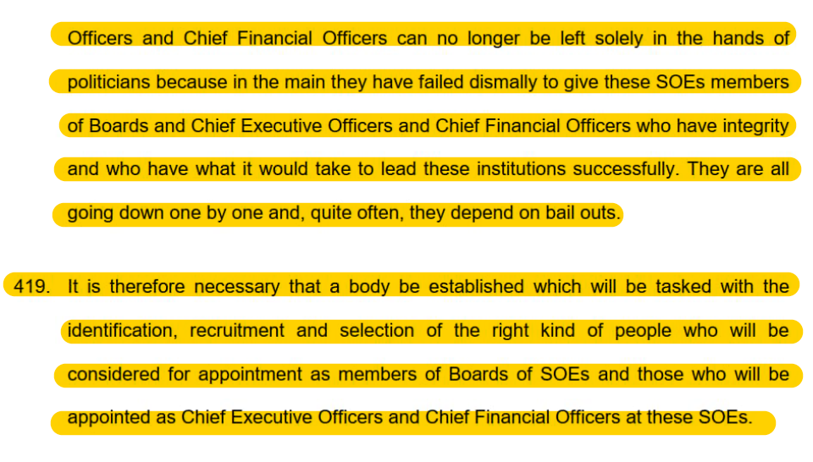
Context
State Capture Commission Volume 1 recommendation:

Slide 3
Context
Report of the Portfolio Committee on Public Service and Administration on consideration of the first, second and third quarter performance 2021/2022 financial years for the budget vote 12 of the Public Service Commission, dated 16 March 2022:
“The Committee was concerned about high number of complaints lodged with the PSC, among top on the list was irregular appointment and Human Resource related matters. These complaints signal that recruitment process in the public service need to be reviewed and strengthened in order to ensure capable and competent personnel are appointed based on merits.”

Slide 4
Context
Report on Budget Vote 12: Public Service Commission, 6 May 2022:
“Currently the Director-General of the PSC is appointed through section 12 of the Public Service Act, 1994, thus making him/her part of employees under the Public Service. Appointment of the PSC Director-General through Public Service Act and participation in the FOSAD structure compromise the independence of the commission.”

Slide 5
Context
Report on Budget Vote 12: Public Service Commission, 6 May 2022:
“Parliament should reconsider the Kader Asmal recommendations of proposing the relocation of Budget Allocations of Institution Supporting Democracy from national departments to the Budget Vote of Parliament, which is consistent with the notion of giving effect to the financial independence of ISDs, as a marker for constitutional independence.”

Slide 6
Context
The letter and spirit of PALGAB is not only entirely consistent with recommendations made by the State Capture Commission, but with recommendations repeatedly made by this very Portfolio Committee.

Slide 7
Aims
Prohibit political office-bearers from employment in the public service
Prohibit special service benefits for DG/HODs who are dismissed from public service
Enhance financial independence of the PSC
Enhance administrative independence of the PSC
Mandate PSC to enforce merit-based appointments free from political interference
Empower PSC to take remedial action

Slide 8
1. Prohibit political office-bearers from public service employment
Provision taken directly from Municipal Systems Amendment Bill, which was recently adopted by the NA
Insertion of Section 35A to Public Service Act, 1994:
35A. (1) An employee may not hold political office in a political party or political organisation, whether in a permanent, temporary or acting capacity.
(2) A person who is an employee when subsection (1) becomes operational, and that holds political office as contemplated in subsection (1)—
(a) must comply with subsection (1) within one year of the commencement of subsection (1); and
(b) must resign from any political office before accepting a promotion, transfer or secondment.
(3) Except for the limitation to hold political office, subsection (1) may not be construed as prohibiting an employee from exercising their other political rights as contemplated in section 19 of the Constitution.’’.

Slide 9
2. Prohibit special service benefits for DG/HODs who are dismissed
Amendment to Section 12 of the Public Service Act, 1994:
‘‘(4) If it is in the public interest and it is allowed by a determination made in terms of section 3(5), an executive authority may, on the conditions provided for in such determination, grant a special service benefit to the head of the relevant department before or at the expiry of his or her term of office or an extended term, or at the time of retirement [or dismissal] from the public service.’’.

Slide 10
3. Enhance financial independence of the PSC
Insert PSC to list of “Constitutional Institutions” listed in Schedule 1 of Public Finance Management Act, 1999
Enhance financial independence of PSC from the organs of state it has oversight over
Correct error made during previous amendment to Schedule 1

Slide 11
4. Enhance administrative independence of the PSC
Removes OPSC from DPSA purview by designating the Chairperson of the PSC as the executive authority of the Commission
Replaces the position of DG of the OPSC with a fully-fledged CEO who reports to the Chairperson of the PSC rather than the Minister of Public Service and Administration
Confers upon the Chairperson, after consultation with the Commission, the power to organise and structure the OPSC
CEO responsible for financial, administrative, and clerical functions

Slide 12
5. Mandate PSC to enforce merit-based appointments
Section 197 (3) of the Constitution: “No employee of the public service may be favoured or prejudiced only because that person supports a particular political party of cause.”
Insert Section 8A to the Public Service Commission Act, 1997 to mandate PSC to issue directions to ensure any decision related to recruitment, transfer and promotion is based on:
(a) ability, demonstrated by proficiency, including training or other qualification, and skill that is required for the relevant area in which the recruitment, transfer or promotion is being done; and
(b) objectivity and fairness, so that any recruitment, transfer or promotion—
(i) is done on merit alone; and
(ii) does not favour or prejudice any person because that person supports, or does not support, a particular political party or cause.

Slide 13
5. Mandate PSC to enforce merit-based appointments
(3) The directions contemplated in subsection (1) must, in order to ensure that employment and personnel management practices are based on objectivity and fairness, include a prohibition on any recruitment, transfer, promotion or dismissal being effected based on, in part or in whole, a particular person’s support of, or opposition to, a particular political party or cause.
…
(7) Any person who fails to comply with a direction under this section shall be guilty of an offence and liable on conviction to a fine or to imprisonment for a period not exceeding 12 months or to both such fine and such imprisonment.

Slide 14
6. Empower PSC to take remedial action
Insert Section 10A to the Public Service Commission Act, 1997 to ensure measures, directions and recommendations issued by the PSC become legally binding
Within 60 days, relevant authority must report to PSC on implementation
Failure to implement will must be reported to provincial or national legislature
PSC mandated to refer irregularities to A-G and SIU

Slide 15
Public Administration Laws General Amendment Bill, 2021
Thank you
Dr Leon Schreiber MP
8 June 2022

