Slide 1
POLICE RECORDED CRIME STATISTICS
REPUBLIC OF SOUTH AFRICA
First Quarter of
2022/2023 Financial year
( April and June 2022)

Slide 2
TABLE OF CONTENTS
Crime statistics analysis
  National crime overview
  Highlights of
    the 17 community-reported serious crimes ,
    Kidnapping
    Crime detected as a result of police actions
  Core Diversion
  Pre-release calendar 2022/2023
  Top 30 Stations
    Contact crimes
    Murder
    Rape
    Kidnapping
    Some subcategories of Robbery Aggravating
              Carjacking
              Robbery at residential premises
              Robbery at non-residential premises
              Truck Hijacking
    Stock-theft

Slide 3
REPUBLIC OF SOUTH AFRICA
CRIME SITUATION
Pre-COVID
Level 5,4,3
Level 1,2
No restriction
CRIME CATEGORY | April to June 2018 | April to June 2019 | April to June 2020 | April to June 2021 | April to June 2022 | Count Diff | % Change
CONTACT CRIMES ( CRIMES AGAINST THE PERSON)
Murder | 4 668 | 5 398 | 3 466 | 5 760 | 6 424 | 664 | 11,5%
Sexual Offences | 11 387 | 12 094 | 7 296 | 12 702 | 11 855 | -847 | -6,7%
Attempted murder | 4 429 | 4 575 | 3 487 | 5 145 | 5 576 | 431 | 8,4%
Assault with the intent to inflict grievous bodily harm | 37 564 | 37 425 | 22 064 | 37 530 | 34 635 | -2 895 | -7,7%
Common assault | 36 024 | 36 185 | 25 995 | 39 406 | 38 627 | -779 | -2,0%
Common robbery | 12 711 | 12 885 | 6 469 | 10 701 | 10 565 | -136 | -1,3%
Robbery with aggravating circumstances | 34 332 | 35 705 | 21 599 | 33 876 | 35 233 | 1 357 | 4,0%
Total Contact Crimes ( Crimes Against The Person) | 141 115 | 144 267 | 90 376 | 145 120 | 142 915 | -2 205 | -1,5%
Total Sexual Offences
Rape | 9 018 | 9 737 | 5 805 | 10 006 | 9 516 | -490 | -4,9%
Sexual Assault | 1 625 | 1 668 | 1 070 | 1 900 | 1 707 | -193 | -10,2%
Attempted Sexual Offences | 451 | 454 | 271 | 514 | 416 | -98 | -19,1%
Contact Sexual Offences | 293 | 235 | 150 | 282 | 216 | -66 | -23,4%
Total Sexual Offences | 11 387 | 12 094 | 7 296 | 12 702 | 11 855 | -847 | -6,7%
SOME SUBCATEGORIES OF AGGRAVATED ROBBERY
Carjacking | 4 002 | 4 550 | 2 677 | 5 146 | 5 866 | 720 | 14,0%
Robbery at residential premises | 5 535 | 5 214 | 4 006 | 5 346 | 5 370 | 24 | 0,4%
Robbery at non-residential premises | 4 779 | 5 100 | 3 341 | 5 255 | 5 281 | 26 | 0,5%
Robbery of cash in transit | 62 | 38 | 19 | 46 | 60 | 14 | 30,4%
Bank robbery | 1 | 0 | 0 | 1 | 0 | -1 | 1 count less
Truck hijacking | 334 | 283 | 198 | 411 | 508 | 97 | 23,6%

Slide 4

SELECTED CONTACT CRIMES
PER RATIO:RSA
CRIME CATEGORY | April to June 2018 | April to June 2019 | April to June 2020 | April to June 2021 | April to June 2022
CONTACT CRIMES ( CRIMES AGAINST THE PERSON)
Murder | 8 | 9 | 6 | 10 | 11
Rape | 16 | 17 | 10 | 17 | 16
Attempted murder | 8 | 8 | 6 | 9 | 9
Assault with the intent to inflict grievous bodily harm | 65 | 64 | 37 | 63 | 57
Common assault | 62 | 62 | 44 | 66 | 64
Common robbery | 22 | 22 | 11 | 18 | 17
PER CAPITA (*RATIO PER 100 000 OF THE POPULATION). MID-YEAR POPULATION ESTIMATES, 2021 SERIES

Slide 5
REPUBLIC OF SOUTH AFRICA
CRIME SITUATION
CRIME CATEGORY | April to June 2018 | April to June 2019 | April to June 2020 | April to June 2021 | April to June 2022 | Count Diff | % Change
CONTACT-RELATED CRIMES
Arson | 945 | 943 | 633 | 978 | 886 | -92 | -9,4%
Malicious damage to property | 26 719 | 26 224 | 18 558 | 26 326 | 26 375 | 49 | 0,2%
Total Contact-Related Crimes | 27 664 | 27 167 | 19 191 | 27 304 | 27 261 | -43 | -0,2%
PROPERTY-RELATED CRIMES
Burglary at non-residential premises | 17 827 | 17 274 | 18 840 | 14 627 | 14 677 | 50 | 0,3%
Burglary at residential premises | 55 247 | 53 433 | 37 128 | 39 477 | 39 638 | 161 | 0,4%
Theft of motor vehicle and motorcycle | 12 181 | 11 835 | 5 564 | 9 433 | 9 335 | -98 | -1,0%
Theft out of or from motor vehicle | 31 651 | 31 467 | 17 533 | 21 310 | 21 213 | -97 | -0,5%
Stock-theft | 7 969 | 7 813 | 7 345 | 6 757 | 6 456 | -301 | -4,5%
Total Property-Related Crimes | 124 875 | 121 822 | 86 410 | 91 604 | 91 319 | -285 | -0,3%
OTHER SERIOUS CRIMES
All theft not mentioned elsewhere | 74 253 | 71 704 | 45 455 | 60 056 | 65 636 | 5 580 | 9,3%
Commercial crime | 21 928 | 21 316 | 15 431 | 24 030 | 25 250 | 1 220 | 5,1%
Shoplifting | 14 817 | 15 747 | 9 632 | 11 281 | 11 132 | -149 | -1,3%
Total Other Serious Crimes | 110 998 | 108 767 | 70 518 | 95 367 | 102 018 | 6 651 | 7,0%
Total 17 Community Reported Serious Crimes | 404 652 | 402 023 | 266 495 | 359 395 | 363 513 | 4 118 | 1,1%
CRIME DETECTED AS A RESULT OF POLICE ACTION
Illegal possession of firearms and ammunition | 3 883 | 3 573 | 2 747 | 3 147 | 3 597 | 450 | 14,3%
Drug-related crime | 76 400 | 39 964 | 18 767 | 31 648 | 35 786 | 4 138 | 13,1%
Driving under the influence of alcohol or drugs | 19 531 | 21 853 | 3 168 | 10 964 | 12 942 | 1 978 | 18,0%
Sexual Offences detected as a result of police action | 1 708 | 2 189 | 411 | 1 428 | 1 897 | 469 | 32,8%
Total Crime Detected As A Result Of Police Action | 101 522 | 67 579 | 25 093 | 47 187 | 54 222 | 7 035 | 14,9%

Slide 6
CONTACT CRIME
Contact crime refers to crimes in which the victims are the targets of violence or instances where the victims are in the vicinity of property that criminals target and are subjected to the use of or threats of violence by perpetrators.
Murder
Attempted Murder
Rape
Robbery with aggravating circumstances
  Carjacking
  Robbery at non-residential premises
  Robbery at residential premises
  Robbery of cash in transit
  Truck Hijacking
Trio

Slide 7
CONTACT CRIME
TRENDS OVER THREE-MONTH PERIOD

Slide 8
CONTACT CRIME
TOP 30 STATIONS
Position | Station | Province | April to June 2018 | April to June 2019 | April to June 2020 | April to June 2021 | April to June 2022 | Count Diff | % Change
1 | NYANGA | WESTERN CAPE | 1 081 | 791 | 711 | 796 | 965 | 169 | 21,2%
2 | JHB CENTRAL | GAUTENG | 1 280 | 1 224 | 449 | 909 | 955 | 46 | 5,1%
3 | ALEXANDRA | GAUTENG | 622 | 652 | 521 | 814 | 857 | 43 | 5,3%
4 | DURBAN CENTRAL | KWAZULU-NATAL | 702 | 745 | 257 | 653 | 805 | 152 | 23,3%
5 | DELFT | WESTERN CAPE | 778 | 826 | 523 | 919 | 802 | -117 | -12,7%
6 | MFULENI | WESTERN CAPE | 710 | 796 | 431 | 771 | 780 | 9 | 1,2%
7 | HARARE | WESTERN CAPE | 530 | 584 | 335 | 660 | 779 | 119 | 18,0%
8 | PLESSISLAER | KWAZULU-NATAL | 659 | 700 | 580 | 816 | 767 | -49 | -6,0%
9 | KHAYELITSHA | WESTERN CAPE | 816 | 917 | 455 | 700 | 767 | 67 | 9,6%
10 | TEMBISA | GAUTENG | 601 | 837 | 522 | 813 | 759 | -54 | -6,6%
11 | MITCHELLS PLAIN | WESTERN CAPE | 962 | 1 026 | 472 | 661 | 735 | 74 | 11,2%
12 | INANDA | KWAZULU-NATAL | 720 | 794 | 525 | 761 | 723 | -38 | -5,0%
13 | UMLAZI | KWAZULU-NATAL | 740 | 846 | 499 | 912 | 716 | -196 | -21,5%
14 | JEPPE | GAUTENG | 651 | 689 | 365 | 582 | 700 | 118 | 20,3%
15 | TEMBA | GAUTENG | 730 | 769 | 454 | 828 | 690 | -138 | -16,7%
16 | HONEYDEW | GAUTENG | 707 | 718 | 480 | 730 | 687 | -43 | -5,9%
17 | HILLBROW | GAUTENG | 1 100 | 1 003 | 465 | 849 | 678 | -171 | -20,1%
18 | IVORY PARK | GAUTENG | 717 | 655 | 568 | 719 | 676 | -43 | -6,0%
19 | AKASIA | GAUTENG | 501 | 506 | 346 | 613 | 659 | 46 | 7,5%
20 | MAMELODI EAST | GAUTENG | 611 | 737 | 506 | 670 | 653 | -17 | -2,5%
21 | KAGISO | GAUTENG | 766 | 754 | 407 | 701 | 633 | -68 | -9,7%
22 | KRAAIFONTEIN | WESTERN CAPE | 800 | 716 | 476 | 672 | 628 | -44 | -6,5%
23 | KWADUKUZA | KWAZULU-NATAL | 540 | 604 | 433 | 614 | 613 | -1 | -0,2%
24 | THOHOYANDOU | LIMPOPO | 403 | 470 | 315 | 527 | 601 | 74 | 14,0%
25 | CAPE TOWN CENTRAL | WESTERN CAPE | 522 | 604 | 158 | 419 | 594 | 175 | 41,8%
26 | RANDFONTEIN | GAUTENG | 541 | 567 | 373 | 632 | 580 | -52 | -8,2%
27 | EMPANGENI | KWAZULU-NATAL | 575 | 531 | 343 | 604 | 570 | -34 | -5,6%
28 | PHILIPPI EAST | WESTERN CAPE | 404 | 396 | 434 | 457 | 569 | 112 | 24,5%
29 | MANKWENG | LIMPOPO | 442 | 507 | 255 | 569 | 561 | -8 | -1,4%
30 | SESHEGO | LIMPOPO | 543 | 425 | 301 | 478 | 546 | 68 | 14,2%

Slide 9
MURDER
TRENDS OVER THREE-MONTH PERIOD

Slide 10
MURDER
TOP 30 STATIONS
Position | Station | Province | April to June 2018 | April to June 2019 | April to June 2020 | April to June 2021 | April to June 2022 | Count Diff
1 | UMLAZI | KWAZULU-NATAL | 49 | 52 | 31 | 73 | 83 | 10
2 | PLESSISLAER | KWAZULU-NATAL | 37 | 41 | 32 | 68 | 69 | 1
3 | MTHATHA | EASTERN CAPE | 41 | 40 | 15 | 37 | 69 | 32
4 | INANDA | KWAZULU-NATAL | 44 | 61 | 39 | 63 | 66 | 3
5 | DELFT | WESTERN CAPE | 60 | 75 | 38 | 63 | 62 | -1
6 | KRAAIFONTEIN | WESTERN CAPE | 46 | 37 | 24 | 67 | 56 | -11
7 | KWADABEKA | KWAZULU-NATAL | 19 | 18 | 8 | 26 | 51 | 25
8 | KWAMASHU E | KWAZULU-NATAL | 20 | 34 | 12 | 23 | 51 | 28
9 | HARARE | WESTERN CAPE | 31 | 50 | 35 | 58 | 50 | -8
10 | NYANGA | WESTERN CAPE | 78 | 53 | 38 | 38 | 50 | 12
11 | JHB CENTRAL | GAUTENG | 27 | 28 | 4 | 21 | 50 | 29
12 | ORANGE FARMS | GAUTENG | 22 | 15 | 18 | 19 | 48 | 29
13 | KAGISO | GAUTENG | 20 | 42 | 17 | 43 | 47 | 4
14 | PHILIPPI EAST | WESTERN CAPE | 46 | 29 | 57 | 33 | 46 | 13
15 | GUGULETHU | WESTERN CAPE | 45 | 34 | 25 | 47 | 43 | -4
16 | KHAYELITSHA | WESTERN CAPE | 54 | 75 | 53 | 49 | 42 | -7
17 | VERULAM | KWAZULU-NATAL | 16 | 20 | 13 | 21 | 42 | 21
18 | MARIANNHILL | KWAZULU-NATAL | 26 | 31 | 20 | 21 | 41 | 20
19 | MFULENI | WESTERN CAPE | 36 | 46 | 20 | 54 | 40 | -14
20 | IVORY PARK | GAUTENG | 26 | 38 | 19 | 38 | 40 | 2
21 | JEPPE | GAUTENG | 29 | 26 | 13 | 22 | 39 | 17
22 | MPUMALANGA KZN | KWAZULU-NATAL | 20 | 33 | 22 | 42 | 36 | -6
23 | HILLBROW | GAUTENG | 32 | 18 | 7 | 22 | 36 | 14
24 | SAMORA MACHEL | WESTERN CAPE | 0 | 32 | 18 | 31 | 35 | 4
25 | KWADUKUZA | KWAZULU-NATAL | 14 | 15 | 14 | 27 | 34 | 7
26 | ALEXANDRA | GAUTENG | 14 | 28 | 12 | 26 | 34 | 8
27 | KWANOBUHLE | EASTERN CAPE | 10 | 13 | 9 | 20 | 34 | 14
28 | LINGELETHU-WEST | WESTERN CAPE | 14 | 28 | 8 | 19 | 34 | 15
29 | EVATON | GAUTENG | 22 | 21 | 12 | 18 | 33 | 15
30 | KWAZAKELE | EASTERN CAPE | 19 | 23 | 17 | 28 | 31 | 3

Slide 11
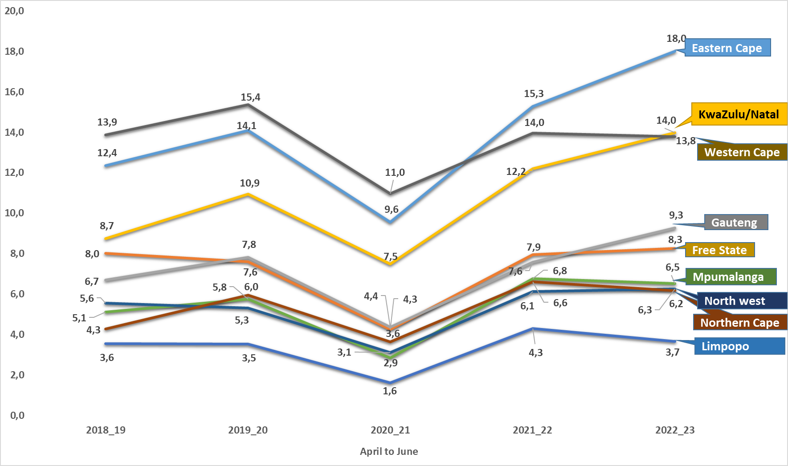
Murder
PER RATIO
PER CAPITA (*RATIO PER 100 000 OF THE POPULATION). MID-YEAR POPULATION ESTIMATES, 2021 SERIES

Slide 12
MURDER: MOTIVE/CAUSATIVE FACTORS
April to June 2022/2023
Murder causative factors | EC | FS | GP | KZN | LP | MP | NW | NC | WC | RSA
Arguments/ Misunderstanding/ Road Rage / Provocation | 99 | 38 | 146 | 259 | 51 | 30 | 47 | 33 | 195 | 898
Retaliation/Revenge/Punishment | 50 | 3 | 11 | 294 | 6 | 1 | 5 | 3 | 111 | 484
Vigilantism / Mob justice | 114 | 13 | 83 | 110 | 32 | 25 | 19 | 1 | 75 | 472
Robbery | 32 | 11 | 71 | 114 | 18 | 17 | 27 | 3 | 65 | 358
Gang-related | 7 | 0 | 6 | 0 | 1 | 0 | 1 | 0 | 161 | 176
Taxi-related | 6 | 0 | 40 | 25 | 0 | 0 | 0 | 0 | 19 | 90
Hijacking and attempts | 3 | 0 | 16 | 12 | 1 | 6 | 4 | 1 | 5 | 48
Law enforcement & security guards in the line of duty(excl. police murder) | 0 | 0 | 7 | 26 | 1 | 0 | 2 | 0 | 5 | 41
During commission of other crimes (not robbery or rape) | 2 | 0 | 5 | 10 | 0 | 2 | 3 | 3 | 7 | 32
Intervention in an argument | 3 | 1 | 8 | 7 | 2 | 3 | 0 | 0 | 1 | 25
Rape-related | 5 | 0 | 1 | 12 | 1 | 0 | 4 | 0 | 1 | 24
Illicit mining | 0 | 0 | 4 | 0 | 2 | 0 | 0 | 1 | 0 | 7
Sample size: murder = 6 106

Slide 13
PLACE OF OCCURRENCE
SOME CATEGORIES OF CONTACT CRIME
April to June 2022/2023
Place of occurrence | Murder | Attempted murder | Assault GBH
Public place e.g. street/open field/recreational centre/park/beach/parking area/abandoned building | 2 733 | 2 014 | 7 915
Residences of perpetrator/victim (including residence known by victims/ perpetrator e.g. family/friends/neighbours) | 1 746 | 1 478 | 10 575
Mode of transport e.g. bus/car/taxi | 242 | 537 | 147
Liquor outlets e.g. shebeen /tavern/pub/night club/bottle store | 227 | 257 | 2 705
Business premises (e.g. mall/restaurants/work place/office park/entertainment centre e.g. movie theatre, gambling facility) | 89 | 206 | 416
Tuckshop | 87 | 136 | 369
Public transport premises (Bus stop/taxi rank, Railway premises e.g. track/station) | 82 | 81 | 130
Agricultural land/farm/plot/small holding | 68 | 49 | 175
Sea/river/lake/pool/dam | 58 | 4 | 5
Dumping site | 24 | 1 | 0
Educational institutions (schools, universities, college, day care facilities) | 19 | 25 | 217
Petrol station | 19 | 39 | 66
Mining area | 17 | 24 | 15
Leisure premises e.g. Hotel/guest house/BnB/motel/holiday resort | 5 | 12 | 31
Prison/holding cells | 1 | 3 | 64
Sample Size: Murder = 6 106 Counts, Attempted Murder = 5 089, Assault GBH = 24 430

Slide 14


SELECTED CONTACT CRIMES AGAINST WOMEN AND CHILDREN
MURDER, ATTEMPTED MURDER AND ASSAULT GBH
April to June 2022/2023
 | WOMEN ( 18+ yrs.) |  |  |  | CHILDREN (0 to 17yrs) Boys and Girls
CRIME CATEGORY | Murder | Attempted murder | Assault GBH |  | Murder | Attempted murder | Assault GBH
April to June 2021 | 558 | 897 | 7 585 |  | 166 | 222 | 1 054
April to June 2022 | 855 | 1 179 | 11 734 |  | 243 | 283 | 1 670
Case Diff | 297 | 282 | 4 149 |  | 77 | 61 | 616
% Change | 53,2% | 31,4% | 54,7% |  | 46,4% | 27,5% | 58,4%

Slide 15
MULTIPLE MURDERS April to June 2022/2023
COUNT OF VICTIMS | NUMBER OF CASES REPORTED PER PROVINCE |  |  |  |  |  |  |  |  | Total
 | Eastern Cape | Free State | Gauteng | KwaZulu- Natal | Limpopo | Mpumalanga | North West | Northern Cape | Western Cape | Dockets | Victims
2 | 47 | 6 | 58 | 58 | 4 | 6 | 10 | 0 | 26 | 215 | 430
3 | 6 | 2 | 9 | 18 | 0 | 3 | 2 | 0 | 8 | 48 | 144
4 | 0 | 0 | 8 | 6 | 1 | 0 | 0 | 0 | 2 | 17 | 68
5 | 1 | 0 | 0 | 1 | 0 | 0 | 0 | 0 | 0 | 2 | 10
6 | 0 | 0 | 0 | 1 | 0 | 0 | 0 | 0 | 1 | 2 | 12
Dockets | 54 | 8 | 75 | 84 | 5 | 9 | 12 | 0 | 37 | 284
Victims | 117 | 18 | 175 | 205 | 12 | 21 | 26 | 0 | 90 |  | 664

Slide 16
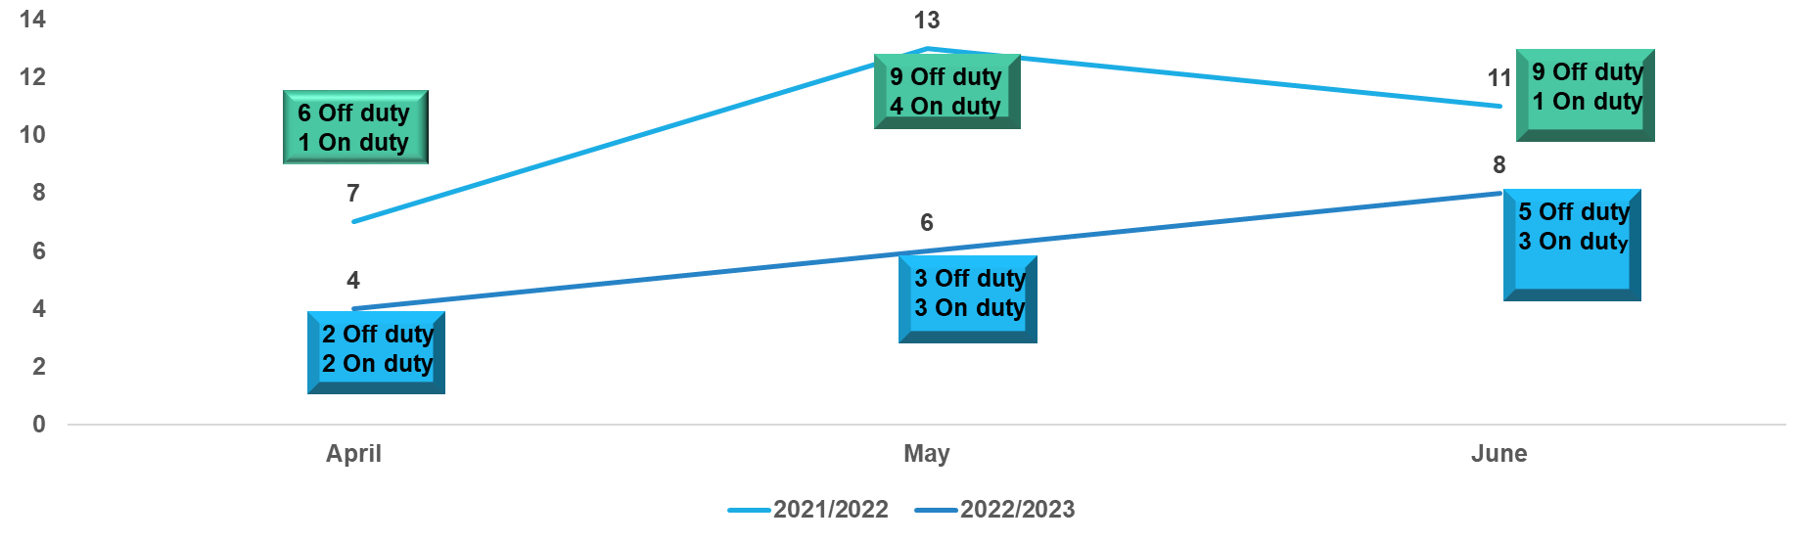
MURDER OF MEMBERS OF THE POLICE
ON/OFF DUTY MEMBERS
TREND OVER THREE-MONTH PERIOD
Apr-Jun | Eastern Cape | Free State | Gauteng | KwaZulu-Natal | Mpumalanga | Western Cape | Total
Off duty | 2 | 0 | 2 | 3 | 1 | 2 | 10
On duty | 1 | 1 | 2 | 2 | 1 | 1 | 8
 | Eastern Cape | Free State | Gauteng | KwaZulu-Natal | Limpopo | Mpumalanga | North West | Western Cape | Total
2021/2022 | 3 | 3 | 6 | 11 | 1 | 1 | 1 | 5 | 31
2022/2023 | 3 | 1 | 4 | 5 | 0 | 2 | 0 | 3 | 18
Counts diff | 0 | -2 | -2 | -6 | -1 | 1 | -1 | -2 | -13

Slide 17
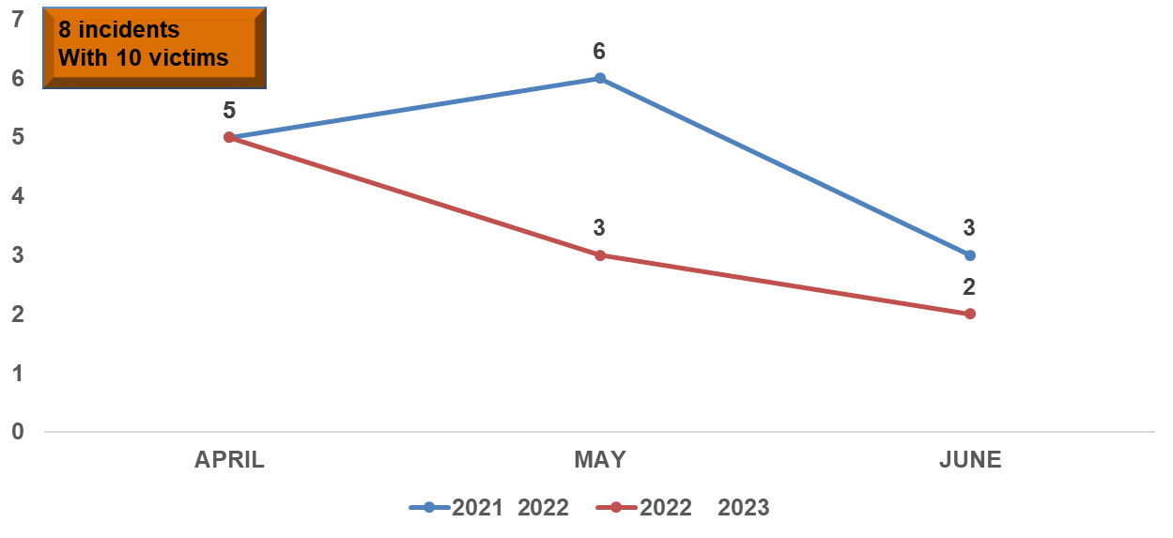
MURDERS OF FARMING COMMUNITY
TREND OVER THREE-MONTH PERIOD
2 Theft of motor vehicles or cycles
2 Attempted Murder
4 Robbery at residential premises
1 Arson
1 Rapes
1 Assault GBH
 | EC | FS |  | GP | KZN | LP | MP | NC | NW | WC | RSA
Murder counts at farms and small holdings (number of victims)
2020 2021 | 1 | 3 | 5 |  | 2 | 0 | 1 | 1 | 0 | 1 | 14
2021 2022 | 2 | 1 | 1 |  | 2 | 1 | 3 | 0 | 3 | 1 | 14
2022 2023 | 1 | 1 | 2 |  | 1 | 3 | 1 | 0 | 0 | 1 | 10
Counts Diff | -1 | 0 | 1 |  | -1 | 2 | -2 | 0 | -3 | 0 | -4

Slide 18
Murder: frequently used instrumentS
2022/2023
Instrument used | Eastern Cape | Free State | Gauteng | Kwazulu-Natal | Limpopo | Mpumalanga | North West | Northern Cape | Western Cape | Total
Firearm | 351 | 63 | 697 | 912 | 46 | 102 | 95 | 2 | 498 | 2 766
Knives | 235 | 68 | 114 | 191 | 33 | 40 | 40 | 28 | 186 | 935
Sharp Instrument | 125 | 33 | 54 | 87 | 18 | 20 | 21 | 4 | 83 | 445
Blunt Instrument | 78 | 15 | 32 | 50 | 14 | 16 | 7 | 3 | 16 | 231
Body part | 31 | 6 | 15 | 23 | 10 | 11 | 9 | 5 | 18 | 128
Stone/ Brick/ Rock | 20 | 6 | 17 | 10 | 8 | 3 | 8 | 2 | 26 | 100

Slide 19
RAPE
TRENDS OVER THREE-MONTH PERIOD

Slide 20
RAPE
TOP 30 STATIONS
Position | Station | Province | April to June 2018 | April to June 2019 | April to June 2020 | April to June 2021 | April to June 2022 | Count Diff
1 | INANDA | KWAZULU-NATAL | 77 | 74 | 39 | 73 | 78 | 5
2 | LUSIKISIKI | EASTERN CAPE | 62 | 59 | 32 | 71 | 73 | 2
3 | DELFT | WESTERN CAPE | 49 | 44 | 41 | 72 | 60 | -12
4 | EMPANGENI | KWAZULU-NATAL | 41 | 49 | 22 | 49 | 56 | 7
5 | THOHOYANDOU | LIMPOPO | 60 | 57 | 30 | 60 | 55 | -5
6 | PLESSISLAER | KWAZULU-NATAL | 41 | 53 | 37 | 39 | 54 | 15
7 | TEMBA | GAUTENG | 41 | 57 | 20 | 48 | 49 | 1
8 | HONEYDEW | GAUTENG | 23 | 23 | 21 | 21 | 49 | 28
9 | MANKWENG | LIMPOPO | 40 | 29 | 25 | 37 | 48 | 11
10 | ESHOWE | KWAZULU-NATAL | 31 | 29 | 20 | 29 | 48 | 19
11 | UMLAZI | KWAZULU-NATAL | 51 | 92 | 27 | 58 | 47 | -11
12 | IVORY PARK | GAUTENG | 46 | 49 | 23 | 43 | 46 | 3
13 | KWADUKUZA | KWAZULU-NATAL | 30 | 35 | 31 | 25 | 45 | 20
14 | SESHEGO | LIMPOPO | 37 | 34 | 21 | 39 | 44 | 5
15 | MBIZANA | EASTERN CAPE | 22 | 44 | 16 | 41 | 43 | 2
16 | GIYANI | LIMPOPO | 31 | 29 | 24 | 42 | 40 | -2
17 | BOLOBEDU | LIMPOPO | 23 | 24 | 9 | 25 | 40 | 15
18 | HARARE | WESTERN CAPE | 35 | 38 | 33 | 49 | 39 | -10
19 | GUGULETHU | WESTERN CAPE | 28 | 35 | 23 | 44 | 39 | -5
20 | BOITEKONG | NORTH WEST | 35 | 29 | 22 | 25 | 39 | 14
21 | MAMELODI EAST | GAUTENG | 41 | 26 | 17 | 25 | 38 | 13
22 | ORANGE FARMS | GAUTENG | 49 | 35 | 30 | 37 | 37 | 0
23 | JEPPE | GAUTENG | 12 | 37 | 14 | 38 | 36 | -2
24 | TSAKANE | GAUTENG | 32 | 32 | 18 | 33 | 36 | 3
25 | MFULENI | WESTERN CAPE | 31 | 37 | 33 | 40 | 35 | -5
26 | DIEPSLOOT | GAUTENG | 32 | 33 | 21 | 34 | 35 | 1
27 | EAST LONDON | EASTERN CAPE | 33 | 30 | 14 | 33 | 35 | 2
28 | DUTYWA | EASTERN CAPE | 33 | 29 | 18 | 29 | 35 | 6
29 | KWAMASHU E | KWAZULU-NATAL | 28 | 37 | 13 | 25 | 35 | 10
30 | LEBOWAKGOMO | LIMPOPO | 17 | 23 | 8 | 23 | 35 | 12

Slide 21
RAPE
PLACE OF OCCURRENCE
Place of occurrence | EC | FS | GP | KZN | LP | MP | NW | NC | WC | Total
Residences of perpetrator/ victim (including residence known by victim/ perpetrator e.g. family/friends/ neighbours) | 369 | 156 | 710 | 996 | 362 | 193 | 335 | 127 | 532 | 3 780
Public place (street/open field/ recreational centre/ park/ beach / parking area / abandoned building) | 107 | 68 | 373 | 341 | 231 | 85 | 147 | 55 | 139 | 1 546
Mode of transport (bus / car / taxi) | 19 | 9 | 14 | 41 | 24 | 0 | 15 | 7 | 29 | 158
Agricultural land / farm / plot / small holding | 5 | 1 | 13 | 28 | 11 | 1 | 3 | 0 | 39 | 101
Educational institutions (school, university, college, day care facility) | 8 | 3 | 23 | 16 | 7 | 1 | 3 | 1 | 5 | 67
Hotel / guest house / BnB/ motel / holiday resort | 4 | 0 | 22 | 8 | 3 | 5 | 5 | 2 | 9 | 58
Liquor outlets (shebeen/ tavern / pub/ night club / bottle store) | 8 | 3 | 9 | 5 | 7 | 3 | 2 | 0 | 2 | 39
Prison/ holding cells | 3 | 1 | 10 | 3 | 5 | 0 | 1 | 1 | 10 | 34
Sea/ river / lake / pool / dam | 1 | 0 | 3 | 16 | 3 | 5 | 1 | 1 | 3 | 33
Public transport premises (bus stop/taxi rank, railway premises e.g. track/station) | 5 | 1 | 10 | 3 | 1 | 0 | 2 | 0 | 1 | 23
Business premises (mall/ restaurant /work place / office park / entertainment centre e.g. movie theatre, gambling facility) | 0 | 0 | 7 | 3 | 1 | 4 | 0 | 0 | 6 | 21
Tuckshop/spaza | 1 | 0 | 1 | 1 | 4 | 0 | 0 | 0 | 2 | 9
Dumping site | 0 | 0 | 1 | 1 | 0 | 2 | 4 | 0 | 0 | 8
Sample size: Rape = 6 330)

Slide 22
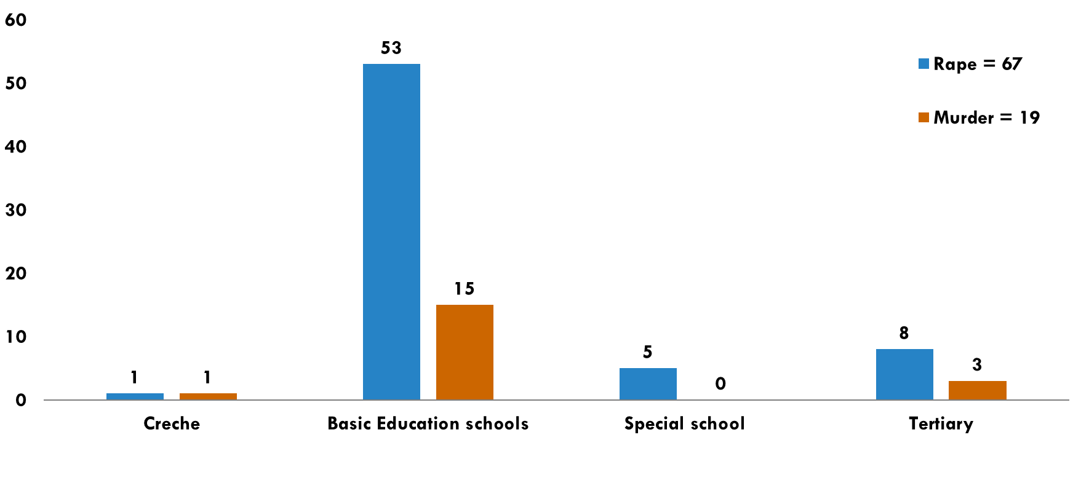
Murder and rape: educational premises
2022/2023( April to June)
*Basic Education Schools : Primary , Secondary, High Schools

Slide 23
CONTACT CRIME: LIQUOR AND DRUG-RELATED OFFENCES: 2022/2023
Confirmed incidents occurred at Liquor Outlets (Tavern/ shebeen/pub/bar/night clubs etc.)
Assault GBH = 2 705
Rape = 39
Murder = 227
Attempted murder = 257

Slide 24
Murder at liquor outlet: most frequently used instrument 2022/2023
Instrument used | Eastern Cape | Free State | Gauteng | Kwazulu-Natal | Limpopo | Mpumalanga | North West | Northern Cape | Western Cape | Total
Firearm | 8 | 2 | 15 | 32 | 3 | 12 | 11 | 0 | 6 | 89
Knives | 22 | 7 | 6 | 13 | 4 | 4 | 4 | 0 | 3 | 63
Sharp Instrument | 6 | 1 | 0 | 5 | 0 | 1 | 2 | 0 | 3 | 18

Slide 25
SELECTED DOMESTIC VIOLENCE-RELATED CRIMES
April to June 2022_2023
BY PROVINCIAL BREAKDOWN AND SEX
Province | Murder | Attempted murder | Rape | Sexual Assault | Assault GBH | Common assault | Common robbery | Robbery aggravating | All theft not mentioned elsewhere | Arson | Malicious damage to property | Burglary at residential premises
Eastern Cape | 36 | 18 | 78 | 18 | 692 | 854 | 10 | 4 | 125 | 12 | 447 | 41
Free State | 19 | 23 | 52 | 9 | 378 | 1 078 | 9 | 2 | 179 | 12 | 400 | 39
Gauteng | 34 | 28 | 127 | 27 | 1 392 | 3 773 | 33 | 16 | 366 | 10 | 1 350 | 64
KwaZulu/Natal | 44 | 50 | 153 | 20 | 671 | 1 297 | 22 | 8 | 150 | 13 | 468 | 28
Limpopo | 6 | 6 | 48 | 3 | 304 | 537 | 8 | 4 | 55 | 5 | 240 | 18
Mpumalanga | 13 | 11 | 37 | 4 | 269 | 434 | 6 | 2 | 29 | 5 | 182 | 11
North West | 7 | 7 | 33 | 4 | 313 | 451 | 11 | 2 | 84 | 9 | 225 | 23
Northern Cape | 11 | 21 | 22 | 4 | 145 | 249 | 3 | 4 | 57 | 3 | 127 | 18
Western Cape | 31 | 23 | 123 | 35 | 1 021 | 3 254 | 33 | 7 | 672 | 44 | 1 213 | 194
Female | 106 | 128 | 641 | 120 | 3 686 | 9 773 | 111 | 30 | 1 148 | 81 | 3 129 | 261
Male | 95 | 59 | 32 | 4 | 1 499 | 2 154 | 24 | 19 | 569 | 32 | 1 523 | 175
RSA | 201 | 187 | 673 | 124 | 5 185 | 11 927 | 135 | 49 | 1 717 | 113 | 4 652 | 436

Slide 26
SOME SUB-CATEGORIES OF ROBBERY WITH AGGRAVATING CIRCUMSTANCES CRIMES
  Carjacking
  Robbery at residential premises
  Robbery at non-residential premises
  Robbery of cash in transit
  Truck Hijacking
TRIO CRIMES

Slide 27
TRIO CRIMES
TRENDS OVER THREE-MONTH PERIOD

Slide 28
TRIO CRIMES
TOP 30 STATIONS
Position | Station | Province | April to June 2018 | April to June 2019 | April to June 2020 | April to June 2021 | April to June 2022 | Count Diff | % Change
1 | NYANGA | WESTERN CAPE | 159 | 132 | 184 | 95 | 141 | 46 | 48,4%
2 | HARARE | WESTERN CAPE | 78 | 89 | 69 | 128 | 140 | 12 | 9,4%
3 | PHILIPPI EAST | WESTERN CAPE | 79 | 89 | 108 | 128 | 128 | 0 | 0,0%
4 | PLESSISLAER | KWAZULU-NATAL | 77 | 74 | 102 | 100 | 128 | 28 | 28,0%
5 | PRETORIA WEST | GAUTENG | 47 | 69 | 39 | 59 | 125 | 66 | 111,9%
6 | UMLAZI | KWAZULU-NATAL | 86 | 107 | 75 | 117 | 124 | 7 | 6,0%
7 | AKASIA | GAUTENG | 103 | 75 | 51 | 93 | 123 | 30 | 32,3%
8 | PINETOWN | KWAZULU-NATAL | 72 | 113 | 53 | 102 | 117 | 15 | 14,7%
9 | TEMBISA | GAUTENG | 73 | 86 | 82 | 112 | 112 | 0 | 0,0%
10 | INANDA | KWAZULU-NATAL | 61 | 89 | 97 | 110 | 111 | 1 | 0,9%
11 | HONEYDEW | GAUTENG | 144 | 135 | 79 | 121 | 108 | -13 | -10,7%
12 | KAGISO | GAUTENG | 69 | 82 | 48 | 96 | 108 | 12 | 12,5%
13 | KWAMASHU E | KWAZULU-NATAL | 34 | 47 | 26 | 59 | 105 | 46 | 78,0%
14 | JHB CENTRAL | GAUTENG | 96 | 95 | 46 | 80 | 101 | 21 | 26,3%
15 | EAST LONDON | EASTERN CAPE | 39 | 31 | 24 | 41 | 101 | 60 | 146,3%
16 | MIDRAND | GAUTENG | 78 | 93 | 39 | 110 | 100 | -10 | -9,1%
17 | JEPPE | GAUTENG | 62 | 76 | 45 | 86 | 100 | 14 | 16,3%
18 | MOROKA | GAUTENG | 50 | 89 | 43 | 73 | 100 | 27 | 37,0%
19 | BOOYSENS | GAUTENG | 93 | 81 | 59 | 81 | 99 | 18 | 22,2%
20 | MOFFATVIEW | GAUTENG | 110 | 64 | 52 | 119 | 98 | -21 | -17,6%
21 | ALEXANDRA | GAUTENG | 64 | 82 | 38 | 84 | 98 | 14 | 16,7%
22 | VERULAM | KWAZULU-NATAL | 46 | 53 | 38 | 65 | 98 | 33 | 50,8%
23 | KEMPTON PARK | GAUTENG | 80 | 83 | 47 | 108 | 97 | -11 | -10,2%
24 | SOSHANGUVE | GAUTENG | 78 | 101 | 49 | 75 | 97 | 22 | 29,3%
25 | OLIEVENHOUTBOSCH | GAUTENG | 76 | 52 | 41 | 124 | 92 | -32 | -25,8%
26 | DELFT | WESTERN CAPE | 80 | 99 | 49 | 109 | 92 | -17 | -15,6%
27 | MFULENI | WESTERN CAPE | 79 | 70 | 43 | 67 | 92 | 25 | 37,3%
28 | VOSLOORUS | GAUTENG | 53 | 74 | 39 | 78 | 90 | 12 | 15,4%
29 | ORANGE FARMS | GAUTENG | 50 | 76 | 47 | 67 | 90 | 23 | 34,3%
30 | RANDFONTEIN | GAUTENG | 45 | 53 | 37 | 66 | 89 | 23 | 34,8%

Slide 29
CARJACKING
TRENDS OVER THREE-MONTH PERIOD

Slide 30
CARJACKING
TOP 30 STATION
Position | Station | Province | April to June 2018 | April to June 2019 | April to June 2020 | April to June 2021 | April to June 2022 | Count Diff | % Change
1 | NYANGA | WESTERN CAPE | 67 | 87 | 133 | 67 | 104 | 37 | 55,2%
2 | PHILIPPI EAST | WESTERN CAPE | 33 | 58 | 48 | 78 | 84 | 6 | 7,7%
3 | HARARE | WESTERN CAPE | 36 | 50 | 31 | 62 | 84 | 22 | 35,5%
4 | MOROKA | GAUTENG | 32 | 47 | 21 | 39 | 70 | 31 | 79,5%
5 | SANDRINGHAM | GAUTENG | 16 | 25 | 18 | 43 | 69 | 26 | 60,5%
6 | MIDRAND | GAUTENG | 29 | 36 | 17 | 55 | 68 | 13 | 23,6%
7 | VOSLOORUS | GAUTENG | 31 | 39 | 18 | 38 | 65 | 27 | 71,1%
8 | ALEXANDRA | GAUTENG | 45 | 45 | 17 | 44 | 63 | 19 | 43,2%
9 | PINETOWN | KWAZULU-NATAL | 21 | 28 | 9 | 37 | 63 | 26 | 70,3%
10 | KEMPTON PARK | GAUTENG | 33 | 35 | 21 | 58 | 57 | -1 | -1,7%
11 | OLIEVENHOUTBOSCH | GAUTENG | 18 | 21 | 16 | 57 | 57 | 0 | 0,0%
12 | KWAMASHU E | KWAZULU-NATAL | 16 | 23 | 9 | 32 | 57 | 25 | 78,1%
13 | MABOPANE | GAUTENG | 18 | 24 | 7 | 26 | 56 | 30 | 115,4%
14 | BRAMLEY | GAUTENG | 28 | 22 | 12 | 32 | 53 | 21 | 65,6%
15 | BOOYSENS | GAUTENG | 47 | 42 | 23 | 29 | 53 | 24 | 82,8%
16 | PRETORIA WEST | GAUTENG | 21 | 31 | 24 | 28 | 53 | 25 | 89,3%
17 | MFULENI | WESTERN CAPE | 28 | 39 | 13 | 29 | 52 | 23 | 79,3%
18 | MAMELODI EAST | GAUTENG | 27 | 30 | 38 | 38 | 51 | 13 | 34,2%
19 | TEMBISA | GAUTENG | 27 | 33 | 26 | 57 | 50 | -7 | -12,3%
20 | EVATON | GAUTENG | 18 | 26 | 18 | 36 | 50 | 14 | 38,9%
21 | UMLAZI | KWAZULU-NATAL | 34 | 48 | 25 | 52 | 49 | -3 | -5,8%
22 | DELFT | WESTERN CAPE | 41 | 49 | 22 | 52 | 48 | -4 | -7,7%
23 | JEPPE | GAUTENG | 33 | 36 | 16 | 43 | 47 | 4 | 9,3%
24 | ALBERTON | GAUTENG | 36 | 37 | 35 | 33 | 47 | 14 | 42,4%
25 | ELDORADO PARK | GAUTENG | 28 | 25 | 22 | 45 | 46 | 1 | 2,2%
26 | AKASIA | GAUTENG | 37 | 28 | 25 | 41 | 44 | 3 | 7,3%
27 | SOSHANGUVE | GAUTENG | 47 | 30 | 25 | 34 | 44 | 10 | 29,4%
28 | ORANGE FARMS | GAUTENG | 22 | 24 | 12 | 36 | 43 | 7 | 19,4%
29 | RABIE RIDGE | GAUTENG | 27 | 19 | 9 | 21 | 43 | 22 | 104,8%
30 | TSAKANE | GAUTENG | 16 | 16 | 21 | 41 | 42 | 1 | 2,4%

Slide 31
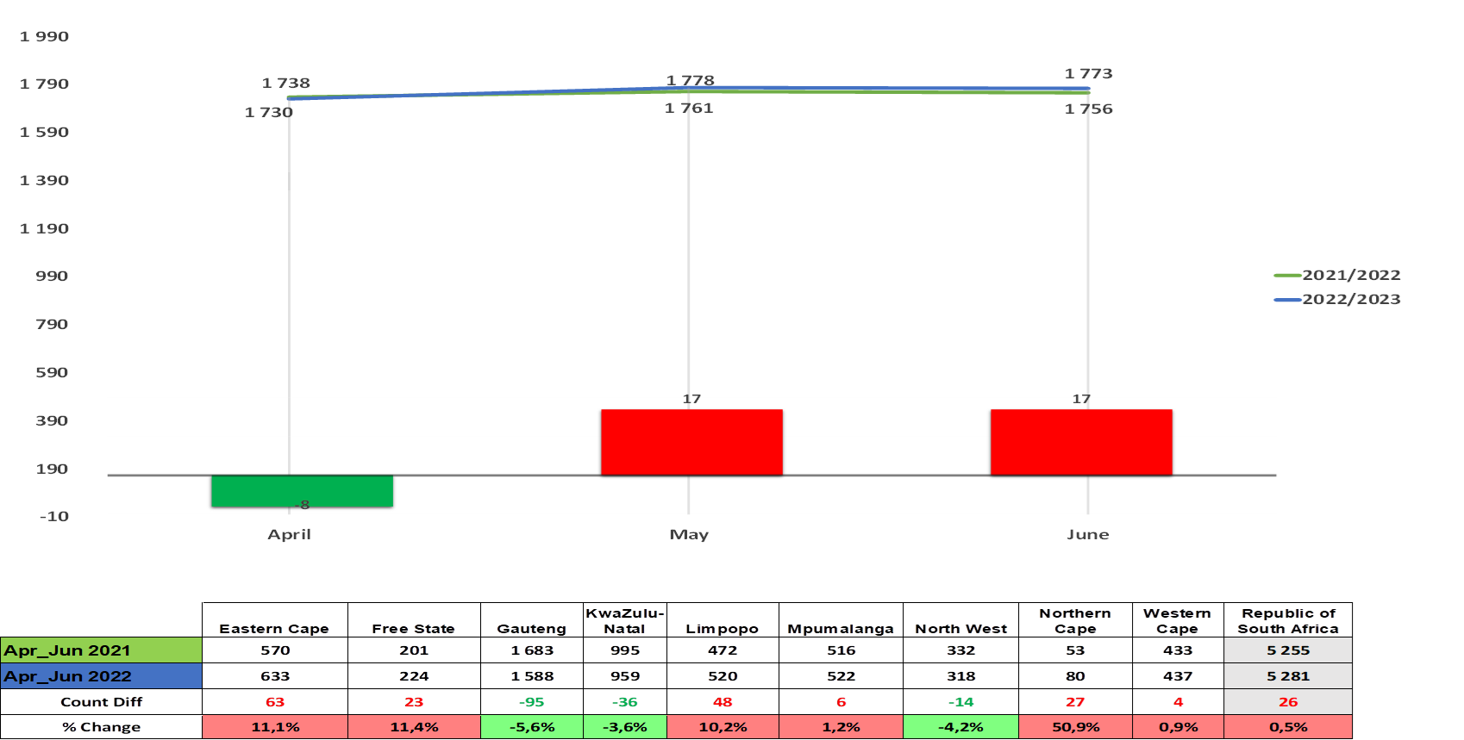
ROBBERY AT NON-RESIDENTIAL PREMISES
TRENDS OVER THREE-MONTH PERIOD

Slide 32
ROBBERY AT NON-RESIDENTIAL PREMISES
TOP 30 STATIONS
Position | Station | Province | April to June 2018 | April to June 2019 | April to June 2020 | April to June 2021 | April to June 2022 | Count Diff
1 | JHB CENTRAL | GAUTENG | 50 | 54 | 27 | 48 | 69 | 21
2 | PIETERMARITZBURG | KWAZULU-NATAL | 9 | 5 | 4 | 28 | 62 | 34
3 | EAST LONDON | EASTERN CAPE | 21 | 16 | 14 | 24 | 62 | 38
4 | DURBAN CENTRAL | KWAZULU-NATAL | 64 | 57 | 15 | 60 | 61 | 1
5 | PRETORIA WEST | GAUTENG | 21 | 19 | 8 | 14 | 42 | 28
6 | THOHOYANDOU | LIMPOPO | 16 | 52 | 20 | 23 | 40 | 17
7 | PINETOWN | KWAZULU-NATAL | 20 | 41 | 30 | 34 | 38 | 4
8 | WITBANK | MPUMALANGA | 37 | 60 | 26 | 32 | 37 | 5
9 | AKASIA | GAUTENG | 34 | 25 | 9 | 25 | 36 | 11
10 | GERMISTON | GAUTENG | 18 | 32 | 16 | 25 | 34 | 9
11 | KEMPTON PARK | GAUTENG | 23 | 33 | 19 | 36 | 31 | -5
12 | TEMBA | GAUTENG | 32 | 36 | 20 | 30 | 31 | 1
13 | VOSMAN | MPUMALANGA | 20 | 23 | 20 | 17 | 31 | 14
14 | PARK ROAD | FREE STATE | 18 | 10 | 4 | 15 | 31 | 16
15 | JEPPE | GAUTENG | 14 | 22 | 17 | 27 | 28 | 1
16 | RUSTENBURG | NORTH WEST | 27 | 30 | 18 | 30 | 27 | -3
17 | MADEIRA | EASTERN CAPE | 19 | 28 | 11 | 25 | 27 | 2
18 | SPRINGS | GAUTENG | 17 | 23 | 20 | 19 | 27 | 8
19 | CALCUTTA | MPUMALANGA | 17 | 38 | 10 | 19 | 27 | 8
20 | TEMBISA | GAUTENG | 17 | 22 | 28 | 19 | 27 | 8
21 | KLERKSDORP | NORTH WEST | 11 | 24 | 7 | 11 | 27 | 16
22 | SESHEGO | LIMPOPO | 37 | 13 | 15 | 22 | 26 | 4
23 | SOSHANGUVE | GAUTENG | 13 | 19 | 15 | 20 | 26 | 6
24 | PRETORIA CENTRAL | GAUTENG | 28 | 12 | 12 | 28 | 25 | -3
25 | MANKWENG | LIMPOPO | 16 | 34 | 17 | 21 | 25 | 4
26 | LEBOWAKGOMO | LIMPOPO | 3 | 25 | 6 | 15 | 25 | 10
27 | BENONI | GAUTENG | 20 | 17 | 5 | 19 | 24 | 5
28 | ORANGE FARMS | GAUTENG | 17 | 16 | 14 | 14 | 24 | 10
29 | MALAMULELE | LIMPOPO | 10 | 24 | 4 | 9 | 24 | 15
30 | KING WILLIAM'S TOWN | EASTERN CAPE | 6 | 4 | 6 | 7 | 24 | 17

Slide 33
ROBBERY AT RESIDENTIAL PREMISES
TRENDS OVER THREE-MONTH PERIOD

Slide 34
ROBBERY AT RESIDENTIAL PREMISES
TOP 30 STATIONS
Position | Station | Province | April to June 2018 | April to June 2019 | April to June 2020 | April to June 2021 | April to June 2022 | Count Diff
1 | PLESSISLAER | KWAZULU-NATAL | 31 | 22 | 31 | 50 | 74 | 24
2 | UMLAZI | KWAZULU-NATAL | 31 | 34 | 33 | 46 | 59 | 13
3 | INANDA | KWAZULU-NATAL | 25 | 47 | 58 | 44 | 57 | 13
4 | KAGISO | GAUTENG | 26 | 24 | 23 | 42 | 57 | 15
5 | KWADUKUZA | KWAZULU-NATAL | 28 | 56 | 32 | 70 | 56 | -14
6 | VERULAM | KWAZULU-NATAL | 21 | 16 | 18 | 25 | 53 | 28
7 | HONEYDEW | GAUTENG | 93 | 55 | 53 | 60 | 49 | -11
8 | HARARE | WESTERN CAPE | 35 | 26 | 35 | 45 | 46 | 1
9 | ESIKHALENI | KWAZULU-NATAL | 22 | 24 | 24 | 32 | 44 | 12
10 | AKASIA | GAUTENG | 32 | 22 | 17 | 27 | 43 | 16
11 | MOFFATVIEW | GAUTENG | 39 | 15 | 9 | 49 | 42 | -7
12 | DELFT | WESTERN CAPE | 31 | 47 | 18 | 54 | 40 | -14
13 | PHILIPPI EAST | WESTERN CAPE | 34 | 24 | 57 | 45 | 40 | -5
14 | SPRINGS | GAUTENG | 32 | 20 | 16 | 18 | 38 | 20
15 | KRAAIFONTEIN | WESTERN CAPE | 23 | 23 | 16 | 34 | 36 | 2
16 | RANDFONTEIN | GAUTENG | 14 | 13 | 13 | 10 | 36 | 26
17 | TEMBISA | GAUTENG | 29 | 31 | 28 | 36 | 35 | -1
18 | MPUMALANGA KZN | KWAZULU-NATAL | 3 | 2 | 11 | 28 | 35 | 7
19 | MFULENI | WESTERN CAPE | 35 | 28 | 22 | 30 | 34 | 4
20 | KHAYELITSHA | WESTERN CAPE | 42 | 43 | 29 | 27 | 34 | 7
21 | KRUGERSDORP | GAUTENG | 18 | 15 | 9 | 22 | 34 | 12
22 | MTUNZINI | KWAZULU-NATAL | 43 | 35 | 30 | 35 | 33 | -2
23 | KWAZAKELE | EASTERN CAPE | 43 | 38 | 35 | 19 | 33 | 14
24 | KWAMASHU E | KWAZULU-NATAL | 13 | 16 | 7 | 9 | 33 | 24
25 | IVORY PARK | GAUTENG | 94 | 31 | 45 | 53 | 32 | -21
26 | BRIXTON | GAUTENG | 31 | 25 | 4 | 10 | 32 | 22
27 | EDENPARK | GAUTENG | 5 | 16 | 20 | 10 | 32 | 22
28 | MTHATHA | EASTERN CAPE | 20 | 20 | 14 | 27 | 30 | 3
29 | PRETORIA WEST | GAUTENG | 5 | 19 | 7 | 17 | 30 | 13
30 | LENASIA SOUTH | GAUTENG | 14 | 7 | 8 | 15 | 30 | 15

Slide 35
ROBBERY OF CASH IN TRANSIT
TRENDS OVER THREE-MONTH PERIOD

Slide 36
TRUCK HIJACKING
TRENDS OVER Three-Month PERIOD

Slide 37
TRUCK HIJACKING
TOP 30 STATIONS
Position | Station | Province | April to June 2018 | April to June 2019 | April to June 2020 | April to June 2021 | April to June 2022 | Count Diff
1 | ORANGE FARMS | GAUTENG | 2 | 2 | 2 | 13 | 14 | 1
2 | AKASIA | GAUTENG | 2 | 4 | 1 | 13 | 13 | 0
3 | KEMPTON PARK | GAUTENG | 8 | 9 | 9 | 11 | 13 | 2
4 | DELMAS | MPUMALANGA | 19 | 9 | 5 | 12 | 11 | -1
5 | BRONKHORSTSPRUIT | GAUTENG | 4 | 9 | 3 | 5 | 11 | 6
6 | BEDFORDVIEW | GAUTENG | 11 | 4 | 2 | 8 | 10 | 2
7 | BOKSBURG NORTH | GAUTENG | 8 | 2 | 3 | 7 | 10 | 3
8 | MONDEOR | GAUTENG | 2 | 7 | 5 | 3 | 10 | 7
9 | OLIFANTSFONTEIN | GAUTENG | 7 | 4 | 4 | 12 | 9 | -3
10 | WESTONARIA | GAUTENG | 4 | 3 | 0 | 4 | 9 | 5
11 | LYTTELTON | GAUTENG | 9 | 0 | 2 | 5 | 8 | 3
12 | KWADWESI | EASTERN CAPE | 0 | 1 | 2 | 3 | 8 | 5
13 | ALBERTON | GAUTENG | 10 | 6 | 1 | 11 | 7 | -4
14 | THE BARRAGE | GAUTENG | 0 | 0 | 2 | 6 | 7 | 1
15 | SUNDRA | MPUMALANGA | 4 | 2 | 0 | 4 | 7 | 3
16 | BEKKERSDAL | GAUTENG | 2 | 3 | 0 | 0 | 7 | 7
17 | GERMISTON | GAUTENG | 2 | 3 | 1 | 5 | 6 | 1
18 | PAARL | WESTERN CAPE | 0 | 0 | 0 | 0 | 6 | 6
19 | BRACKENDOWNS | GAUTENG | 2 | 5 | 3 | 5 | 5 | 0
20 | VANDERBIJLPARK | GAUTENG | 1 | 1 | 2 | 3 | 5 | 2
21 | BRITS | NORTH WEST | 2 | 0 | 1 | 1 | 5 | 4
22 | SWARTKOPS | EASTERN CAPE | 1 | 4 | 2 | 1 | 5 | 4
23 | LANGLAAGTE | GAUTENG | 0 | 1 | 0 | 1 | 5 | 4
24 | HEIDELBERG (GP) | GAUTENG | 11 | 7 | 4 | 6 | 4 | -2
25 | PARYS | FREE STATE | 2 | 0 | 1 | 5 | 4 | -1
26 | KLIPRIVIER | GAUTENG | 8 | 5 | 6 | 5 | 4 | -1
27 | BOKSBURG | GAUTENG | 2 | 0 | 1 | 5 | 4 | -1
28 | BUSHBUCKRIDGE | MPUMALANGA | 1 | 1 | 0 | 4 | 4 | 0
29 | FOCHVILLE | GAUTENG | 2 | 0 | 0 | 3 | 4 | 1
30 | SPRINGS | GAUTENG | 2 | 1 | 0 | 2 | 4 | 2

Slide 38
KIDNAPPING
TRENDS OVER THREE-MONTH PERIOD

Slide 39
KIDNAPPING
TOP 30 STATIONS
Position | Station | Province | April to June 2018 | April to June 2019 | April to June 2020 | April to June 2021 | April to June 2022 | Count Diff
1 | VOSLOORUS | GAUTENG | 2 | 2 | 7 | 11 | 77 | 66
2 | KEMPTON PARK | GAUTENG | 24 | 32 | 25 | 3 | 45 | 42
3 | JEPPE | GAUTENG | 10 | 15 | 4 | 31 | 42 | 11
4 | RIETGAT | GAUTENG | 5 | 5 | 3 | 6 | 42 | 36
5 | BOOYSENS | GAUTENG | 0 | 4 | 1 | 5 | 42 | 37
6 | MONDEOR | GAUTENG | 6 | 1 | 3 | 8 | 41 | 33
7 | EVATON | GAUTENG | 9 | 8 | 3 | 7 | 41 | 34
8 | INANDA | KWAZULU-NATAL | 7 | 11 | 13 | 44 | 40 | -4
9 | DELMAS | MPUMALANGA | 35 | 13 | 13 | 43 | 40 | -3
10 | MIDRAND | GAUTENG | 0 | 0 | 2 | 20 | 39 | 19
11 | JHB CENTRAL | GAUTENG | 15 | 14 | 8 | 33 | 38 | 5
12 | MOFFATVIEW | GAUTENG | 4 | 9 | 2 | 20 | 36 | 16
13 | VANDERBIJLPARK | GAUTENG | 4 | 4 | 2 | 5 | 35 | 30
14 | MOROKA | GAUTENG | 10 | 13 | 5 | 17 | 34 | 17
15 | GERMISTON | GAUTENG | 2 | 5 | 1 | 1 | 33 | 32
16 | RANDFONTEIN | GAUTENG | 10 | 19 | 10 | 35 | 32 | -3
17 | ORANGE FARMS | GAUTENG | 8 | 8 | 3 | 13 | 29 | 16
18 | UMLAZI | KWAZULU-NATAL | 3 | 9 | 8 | 40 | 28 | -12
19 | WESTONARIA | GAUTENG | 9 | 2 | 0 | 11 | 28 | 17
20 | BOKSBURG NORTH | GAUTENG | 1 | 2 | 3 | 3 | 28 | 25
21 | ALBERTON | GAUTENG | 3 | 4 | 2 | 2 | 28 | 26
22 | TEMBISA | GAUTENG | 29 | 16 | 11 | 27 | 27 | 0
23 | SOSHANGUVE | GAUTENG | 5 | 3 | 0 | 13 | 27 | 14
24 | LENASIA | GAUTENG | 8 | 3 | 1 | 10 | 27 | 17
25 | SUNNYSIDE | GAUTENG | 1 | 3 | 0 | 5 | 27 | 22
26 | MABOPANE | GAUTENG | 0 | 4 | 0 | 4 | 27 | 23
27 | DURBAN CENTRAL | KWAZULU-NATAL | 8 | 9 | 3 | 23 | 26 | 3
28 | VERULAM | KWAZULU-NATAL | 6 | 13 | 12 | 19 | 25 | 6
29 | PINETOWN | KWAZULU-NATAL | 5 | 5 | 5 | 16 | 24 | 8
30 | PRETORIA CENTRAL | GAUTENG | 10 | 5 | 3 | 4 | 24 | 20

Slide 40
KIDNAPPING: CIRCUMSTANCES/CAUSATIVE FACTORS
 | EC | FS | GP | KZN | LP | MP | NW | NC | WC | Total
Sample size | 162 | 117 | 1 902 | 569 | 95 | 223 | 131 | 15 | 212 | 3 426
Hijacking-related | 15 | 26 | 1 113 | 134 | 4 | 79 | 21 | 0 | 51 | 1 443
Robbery-related | 28 | 15 | 242 | 11 | 20 | 40 | 28 | 3 | 49 | 436
Rape-related | 15 | 24 | 81 | 95 | 13 | 23 | 23 | 1 | 21 | 296
Retaliation/revenge | 22 | 14 | 83 | 48 | 5 | 21 | 7 | 7 | 17 | 224
Taxi-related | 2 | 1 | 110 | 38 | 2 | 2 | 0 | 0 | 9 | 164
Domestic-related | 18 | 5 | 28 | 29 | 6 | 10 | 13 | 0 | 12 | 121
Ransom | 8 | 7 | 44 | 5 | 3 | 9 | 6 | 1 | 3 | 86
Children Removed From Guardian/Parent Without Permission | 2 | 3 | 24 | 18 | 15 | 5 | 4 | 0 | 6 | 77
Intimidation | 4 | 1 | 19 | 11 | 4 | 1 | 2 | 0 | 3 | 45
Mob Justice | 4 |  | 1 | 0 | 0 | 0 | 4 | 0 | 0 | 9
Extortion | 2 | 3 | 37 | 5 | 0 | 2 | 2 | 0 | 3 | 54
Sexual Assault | 0 | 0 | 1 | 0 | 0 | 0 | 1 | 0 | 0 | 2
Human Trafficking | 0 | 1 | 13 | 0 | 0 | 2 | 0 | 0 | 1 | 17

Slide 41
Stock-Theft
TRENDS OVER THREE-MONTH PERIOD

Slide 42
Stock-theft
TOP 30 STATIONS
Position | Station | Province | April to June 2018 | April to June 2019 | April to June 2020 | April to June 2021 | April to June 2022 | Count Diff
1 | TSOLO | EASTERN CAPE | 37 | 40 | 51 | 73 | 65 | -8
2 | AMANGWE | KWAZULU-NATAL | 55 | 47 | 42 | 61 | 62 | 1
3 | QUMBU | EASTERN CAPE | 53 | 50 | 101 | 79 | 53 | -26
4 | MTHATHA | EASTERN CAPE | 62 | 58 | 73 | 66 | 50 | -16
5 | UTRECHT | KWAZULU-NATAL | 72 | 45 | 58 | 42 | 50 | 8
6 | BITYI | EASTERN CAPE | 65 | 69 | 58 | 51 | 44 | -7
7 | SIYABUSWA | MPUMALANGA | 40 | 47 | 29 | 44 | 44 | 0
8 | TAUNG | NORTH WEST | 20 | 31 | 34 | 43 | 43 | 0
9 | ESTCOURT | KWAZULU-NATAL | 58 | 48 | 23 | 42 | 41 | -1
10 | SULENKAMA | EASTERN CAPE | 65 | 88 | 104 | 64 | 39 | -25
11 | IMPENDLE | KWAZULU-NATAL | 27 | 48 | 49 | 49 | 39 | -10
12 | HARRISMITH | FREE STATE | 71 | 56 | 36 | 47 | 39 | -8
13 | INTSIKENI | KWAZULU-NATAL | 32 | 39 | 38 | 46 | 39 | -7
14 | MMABATHO | NORTH WEST | 32 | 25 | 35 | 16 | 39 | 23
15 | MOUNT FRERE | EASTERN CAPE | 69 | 44 | 67 | 29 | 38 | 9
16 | BULWER | KWAZULU-NATAL | 25 | 35 | 33 | 28 | 37 | 9
17 | TAYLORS HALT | KWAZULU-NATAL | 47 | 49 | 58 | 46 | 36 | -10
18 | MADIKWE | NORTH WEST | 12 | 18 | 22 | 28 | 36 | 8
19 | LEBOWAKGOMO | LIMPOPO | 29 | 47 | 29 | 22 | 36 | 14
20 | DANNHAUSER | KWAZULU-NATAL | 55 | 43 | 47 | 50 | 34 | -16
21 | MQANDULI | EASTERN CAPE | 37 | 19 | 19 | 20 | 34 | 14
22 | MACLEAR | EASTERN CAPE | 28 | 23 | 23 | 14 | 34 | 20
23 | VENTERSDORP | NORTH WEST | 39 | 34 | 18 | 24 | 33 | 9
24 | KWAMHLANGA | MPUMALANGA | 37 | 26 | 12 | 18 | 33 | 15
25 | HLOBANE | KWAZULU-NATAL | 22 | 26 | 24 | 45 | 32 | -13
26 | DAGGAKRAAL | MPUMALANGA | 27 | 19 | 24 | 41 | 32 | -9
27 | CAROLINA | MPUMALANGA | 23 | 18 | 17 | 33 | 32 | -1
28 | VRYHEID | KWAZULU-NATAL | 42 | 25 | 22 | 22 | 32 | 10
29 | DENNILTON | LIMPOPO | 32 | 23 | 15 | 12 | 32 | 20
30 | NTABAMHLOPHE | KWAZULU-NATAL | 30 | 40 | 38 | 39 | 31 | -8

Slide 43
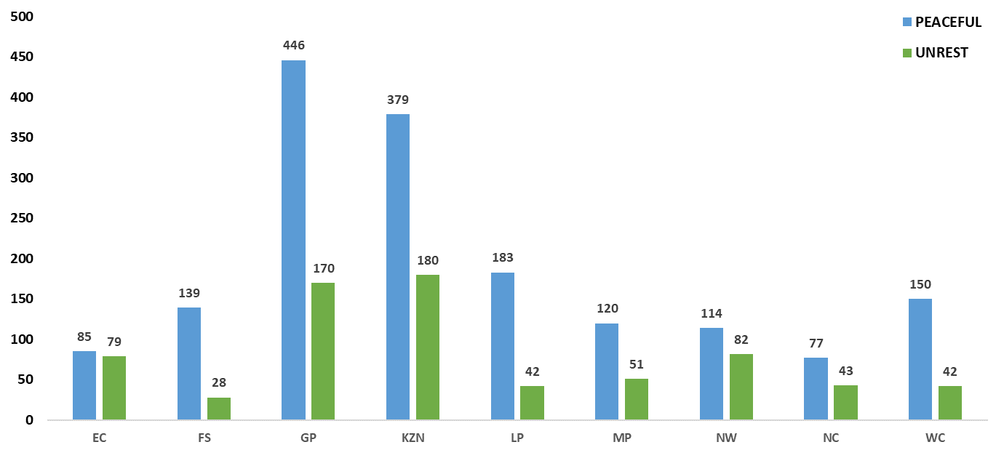
Core diversion

Slide 44
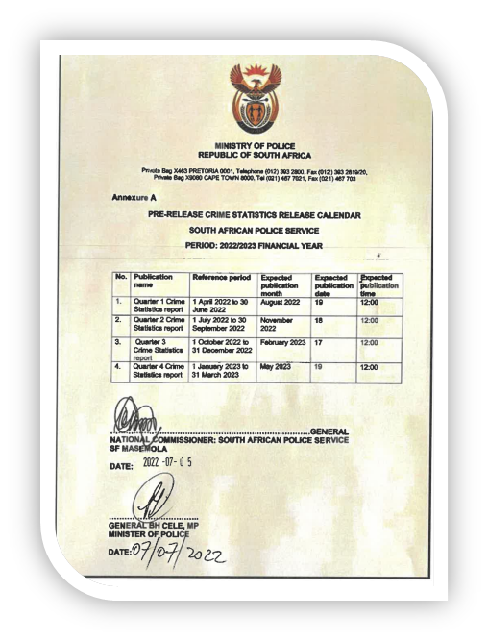
Approved pre-Released calendar

Slide 45
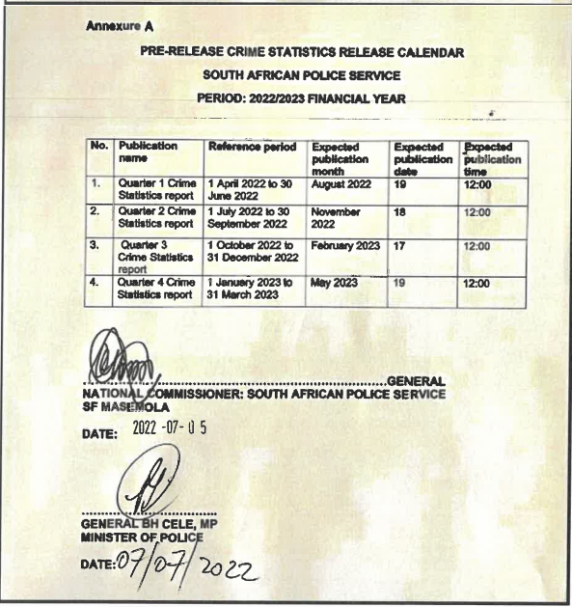

Slide 46
THE END
Thank you

