Slide 1



PORTFOLIO COMMITTEE ON HUMAN SETTLEMENTS
REPORT ON
UMBULWANE AREA H HOUSING PROJECT
28 July 2026
Inspiring Hope for a Better Future
Umuntu Ngumuntu Ngekhaya

Slide 2
CONTENTS
Project Details
Background
Progress Made
3. Challenges
4. Way Forward
TITLE
Inspiring Hope for a Better Future
Umuntu Ngumuntu Ngekhaya

Slide 3
1. PROJECT DETAILS
Project Name : Umbulwane Area H Housing Project
Project Type : IRDP
Implementing Agent : Sarkum Devcon
No. of Sites : 505
Project Value : R120 869 044.37
Project Expenditure : R56 661 368,14
Contract start date : 10 May 2026
Contract end date : 10 May 2027
Inspiring Hope for a Better Future
Umuntu Ngumuntu Ngekhaya

Slide 4
2. BACKGROUND
The Stage 3 application for house construction was approved on 28 March 2018 and the agreement concluded in August 2018.
Severe weather patterns in November 2018 to February 2019 led to the Umbulwane area experiencing extended heavy rainfall which resulted in the existing stormwater arrangements not able to limit/mitigate the extensive flooding of portions of the project impacting on a number of houses under construction. The KZN NHBRC inspectorate inspected the impact of flooding and elevated the matter to the head office. The decision was to immediately stop the construction activities until an appropriate and sustainable solution was found.
Following the tabling of the investigation, a number of meetings were held with all the stakeholders to discuss the findings and provide suitable and sustainable solutions in order to urgently implement and unblock the project. The IA and the Project Engineers subsequently provided the remedial and upgrading requirements.
Inspiring Hope for a Better Future
Umuntu Ngumuntu Ngekhaya

Slide 5
2. BACKGROUND_CONTINUED
During the installation of the services, an application from the District Municipality, via the Local ADM citing that they did not have the funds to install bulk water and sewer arrangements.
In February 2020 the Honourable MEC for Human Settlements and Public Works approved the realignment of R3 319 006.45 for the funding to undertake the remedial and upgrade works to the stormwater arrangements on the Umbulwane Area H Housing Project.
In July 2020 the erstwhile Honourable MEC for Human Settlements and Public Works approved funding of R4 138 272.68 to undertake the installation of the secondary bulk water and sewer outfall connector requirements on the Umbulwane Area H Housing Project.
During the construction of the new pump station and bulk outfall sewer line of the Umbulwane Area H Housing Project, the IA was instructed by uThukela District Municipality to change the design of the pump station from the previously approved submersible pump housed in a manhole to a pump house which included two pumps and substantially enhanced security elements to mitigate against theft and vandalism.
Inspiring Hope for a Better Future
Umuntu Ngumuntu Ngekhaya

Slide 6
2. BACKGROUND_CONTINUED
During the installation of the services, an application from the District Municipality, via the Local ADM citing that they did not have the funds to install bulk water and sewer upgrade.
In October 2022 the erstwhile Honourable MEC for Human Settlements and Public Works approved funding of R3 176 257.95 to undertake the upgrading and construction of the sewer pump station, provision of the electrical connection and bulk meter arrangements and undertake the augmentation to the existing sewer reticulation to support the implementation of the Umbulwane area H Housing Project.
Several letters have been written to the uThukela District Municipality as well as COGTA informing them of the challenges faced in the project as well as requesting their assistance where applicable.
On 25 February 2025, the MEC approved the request to utilize the Municipal Housing Operating Account (MHOA) to pay for unpaid invoices and to pay for the connection the bulk sewer to pump 8 as the District did not have funding.
Inspiring Hope for a Better Future
Umuntu Ngumuntu Ngekhaya

Slide 7
3. PROGRESS MADE
Approved Beneficiaries: 505
Transferred: 446
Slabs completed: 450
Wall plates completed: 412
Roofs completed: 294
Completed Units: 90
Inspiring Hope for a Better Future
Umuntu Ngumuntu Ngekhaya

Slide 8
4. CHALLENGES
The sewer pump house has been completed; however, it was broken into and vandalised and is currently not operational.
Pump Stations 6 and 8 were also broken into and vandalised and are currently not operational.
The transformer supplying electricity to the pump house has been damaged and is currently non-operational.
Due to the financial constraints faced by the Department, the pace of project implementation has slowed significantly.
TITLE
Inspiring Hope for a Better Future
Umuntu Ngumuntu Ngekhaya

Slide 9
4. WAY FOWARD
The Head of Department of the Department of Human Settlements convened a meeting with senior management from both the Alfred Duma Local Municipality and the uThukela District Municipality. The Head of Department specifically requested that the meeting be attended by senior municipal officials to ensure that decisions could be taken at the appropriate level.
The purpose of the meeting was to discuss the persistent sewer infrastructure challenges affecting the project area and to identify practical and sustainable interventions to address these challenges.
As an outcome of the meeting, a dedicated Task Team was established with the sole responsibility of coordinating and expediting the resolution of all sewer-related challenges within the project area.
Inspiring Hope for a Better Future
Umuntu Ngumuntu Ngekhaya

Slide 10
4. WAY FORWARD_CONTINUED
Subsequently, the Department received a formal letter of commitment from the uThukela District Municipality confirming its commitment to addressing the identified sewer infrastructure challenges. In line with this commitment, repairs to the vandalized pump stations are currently underway. Upon completion of these repairs, the IA will proceed with the the required sewer connections, thereby facilitating the completion of the affected housing units.
The District Municipality has further authorised that 250 houses can be connected to the existing pump station prior to augmentation. So the Implementing Agent will increase the number of connected houses from 90 to 250 units.
The District will further find the solution to augment the pump station 6 and 8 in order to connect the remaining 255 units
Inspiring Hope for a Better Future
Umuntu Ngumuntu Ngekhaya

Slide 11
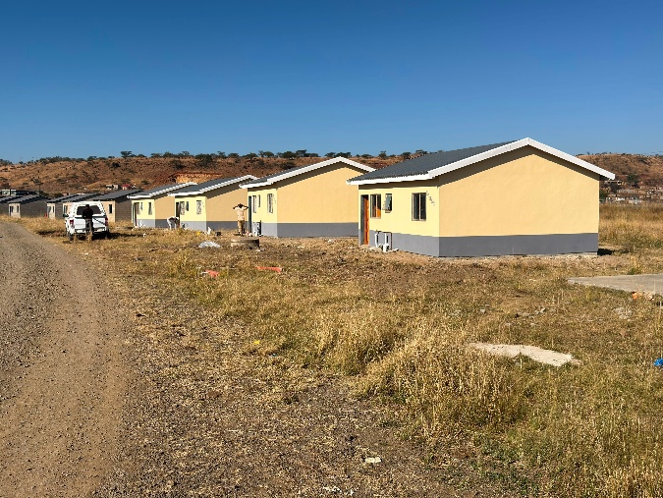
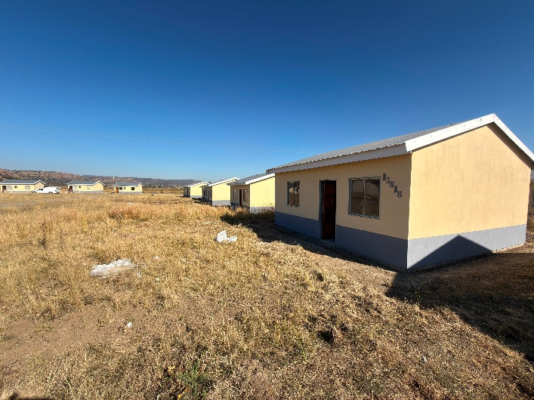
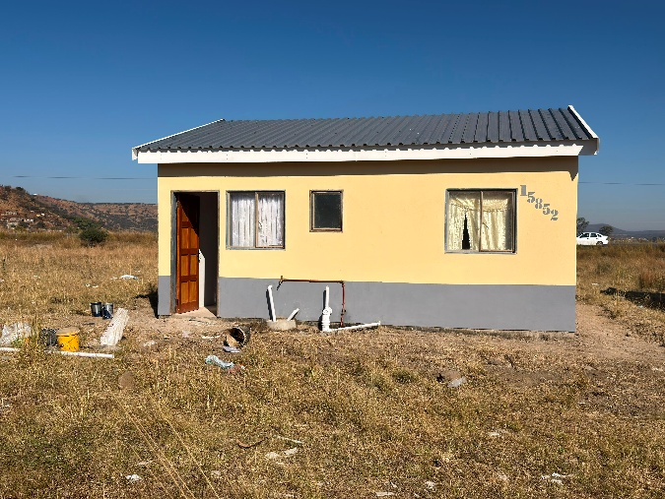
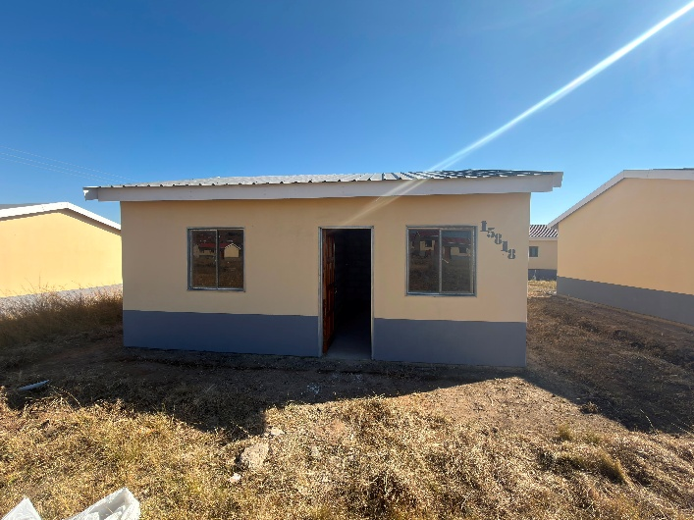
5. VISUAL PICTURES
Inspiring Hope for a Better Future
Umuntu Ngumuntu Ngekhaya

Slide 12








THANK YOU
INSPIRING NEW HOPE
TOGETHER, BUILDING HOMES, CHANGING LIVES
(031) 336 5300 (dbn)
(033) 392 6400 (pmb)
@kzndohs
www.kzndhs.gov.za
Kwazulu-Natal Department of Human Settlements
@kzn.humansettlements
0800 701 701
ANTI-FRAUD E-MAIL:
fraudhotline@kzndhs.gov.za

