Slide 1



UPDATE ON THE RESETTLEMENT OF 2022 FLOOD VICTIMS
11 AUGUST2026
Inspiring Hope for a Better Future
Umuntu Ngumuntu Ngekhaya

Slide 2
PURPOSE
The purpose of this memorandum is to apprise The HS Portfolio Committee On Provision of Permanent Housing for Flood Victims including
  The Refurbishment and Readiness on Montclair Lodge
  Number of families that have moved to permanent homes
  Providing Numbers of closed & remaining Transitional Emergency Accommodations (TEAs) in Ethekwini
  Give highlights on the envisaged developments going forward
TITLE
BACKGROUND
Resolution no. /12/06/2026: Noting the report on the flood victim housing delivery, the Committee resolved that the Department should provide a detailed timeline and list of remaining flood victims in temporary accommodation, including expected dates for formal housing allocation and prioritization of those longest in temporary units
Inspiring Hope for a Better Future
Umuntu Ngumuntu Ngekhaya

Slide 3
Montclair Lodge is a government owned Transitional Emergency Accommodation. The facility was bought from Transnet and it had to be repurposed to address the current and future emergency housing situations around eThekwini. The following is registered with respect to Montclair Lodge:
  Refurbishment for the first One hundred and thirty-six (136) rooms has been completed, and 104 Families relocated to Montclair Lodge between 27 and 30 June 2026.
  This relocation to the refurbished 136 rooms resulted in the closure of Mahatma Ghandi TEA.
  The Refurbishment of an additional 160 rooms are due for completion in July 2026. An additional 130 families are earmarked for relocation to these rooms in August 2026.
  The above developments constitute Phase 1 on Montclair Lodge refurbishment, the KZN DPW is finalising Designs and BOQ for the next phase ( Phase 2).
Update: The Refurbishment & Readiness on Montclair Lodge
TITLE
Inspiring Hope for a Better Future
Umuntu Ngumuntu Ngekhaya

Slide 4
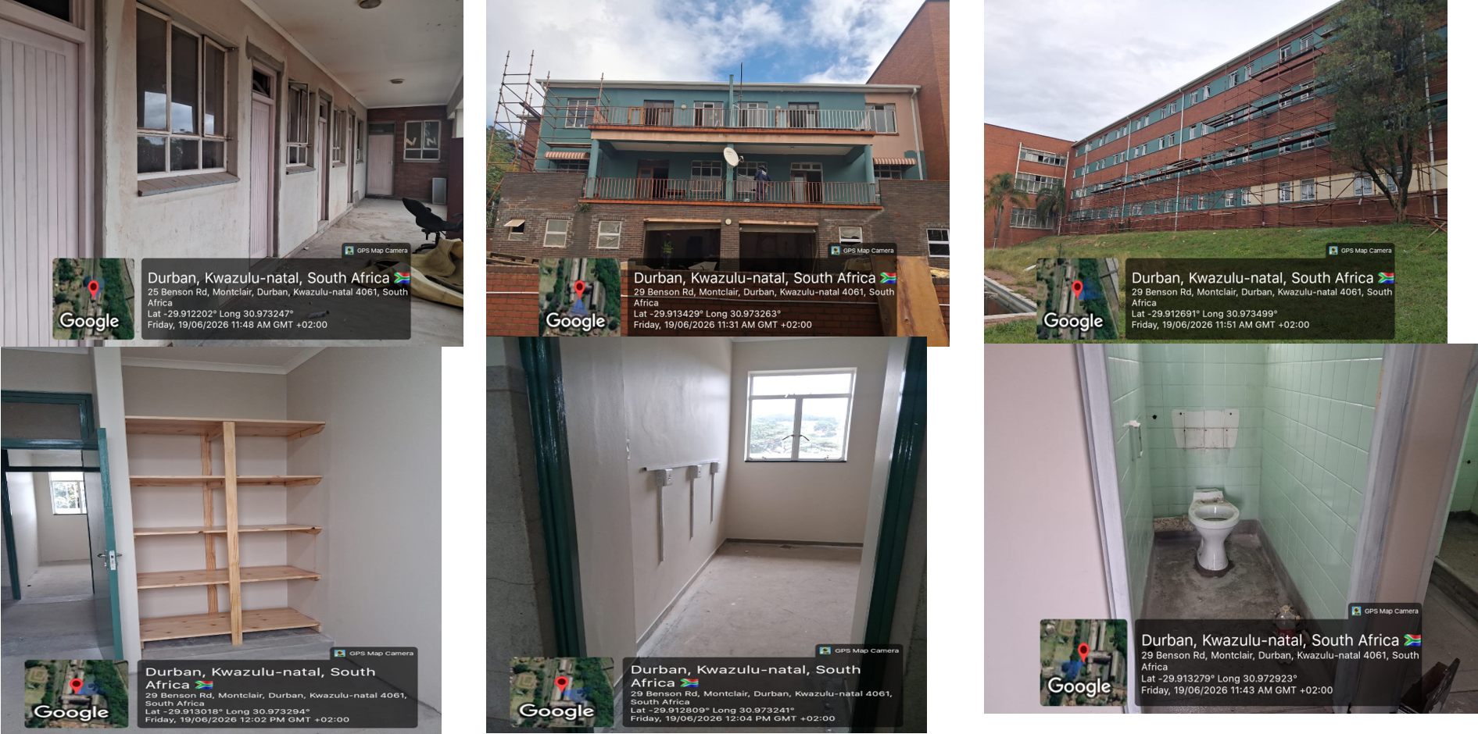
Update: The Refurbishment Work At Montclair Lodge
TITLE
Inspiring Hope for a Better Future
Umuntu Ngumuntu Ngekhaya

Slide 5
UPDATE:Families That Have Moved to Permanent Homes
The Committee is apprised that flood victim families in various parts of KZN have moved to permanent homes using different instruments as outlined below:
  During 2025/26 financial year the KZN DHS built 8506 houses wherein 2062 were for the removal of mud houses ( disaster response).
  Old Mutual foundation has completed 78 of the 80 donated houses purely for identified flood victims in Zululand, uThukela, eThekwini Ilembe and KCDM
  The Development Bank of SA has completed 26 of the donated 200 houses purely for 2022 flood victims in areas such as Ugu, uThukela, eThekwini Ilembe, KCDM and Umgungundlovu
  The KZN DHS has built Seventeen (17) BNG houses in Copesville, Pietermaritzburg, resulting in the closure of a TEA in Pietermaritzburg.
  The KZN DHS has built thirty-seven (37) houses in Illovo-Durban resulting in the closure of 2 TEAs in eThekwini (Ilfracombe & Adams).
  The completed One hundred and thirteen (113) houses in Cornubia has assisted in the closure of two (2) TEAs in Ethekwini.(Dassenhoek & 152 O’ Flaherty Road).
TITLE
Inspiring Hope for a Better Future
Umuntu Ngumuntu Ngekhaya

Slide 6
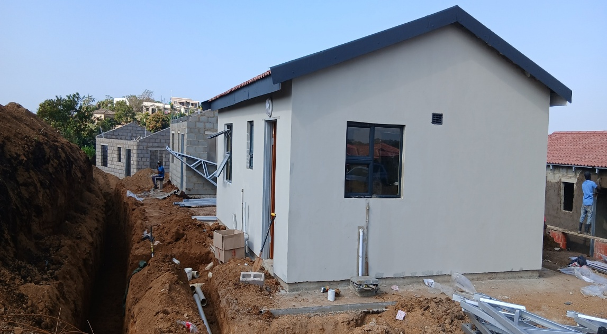
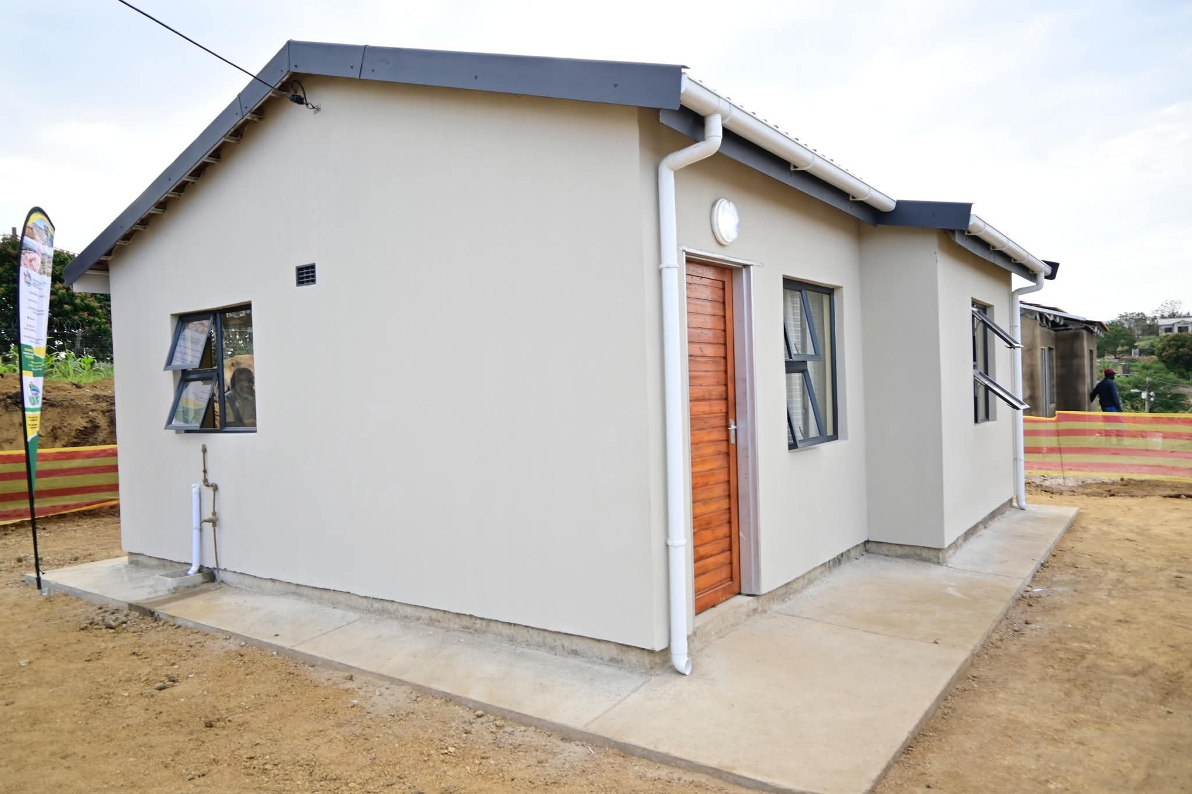
Pictures of Completed 37 House in Illovu

Slide 7
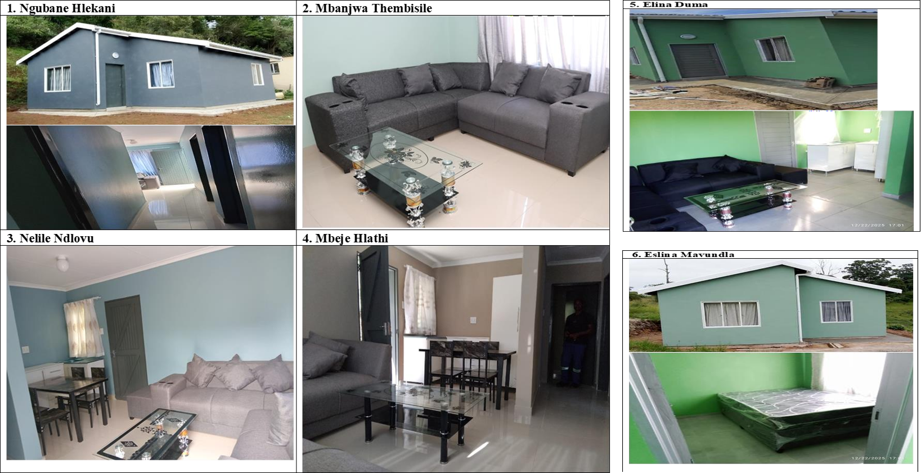
HOUSES BUILT BY OLD MUTUAL FOUNDATION
78 of The Donated 80 houses Completed
TITLE
Inspiring Hope for a Better Future
Umuntu Ngumuntu Ngekhaya

Slide 8
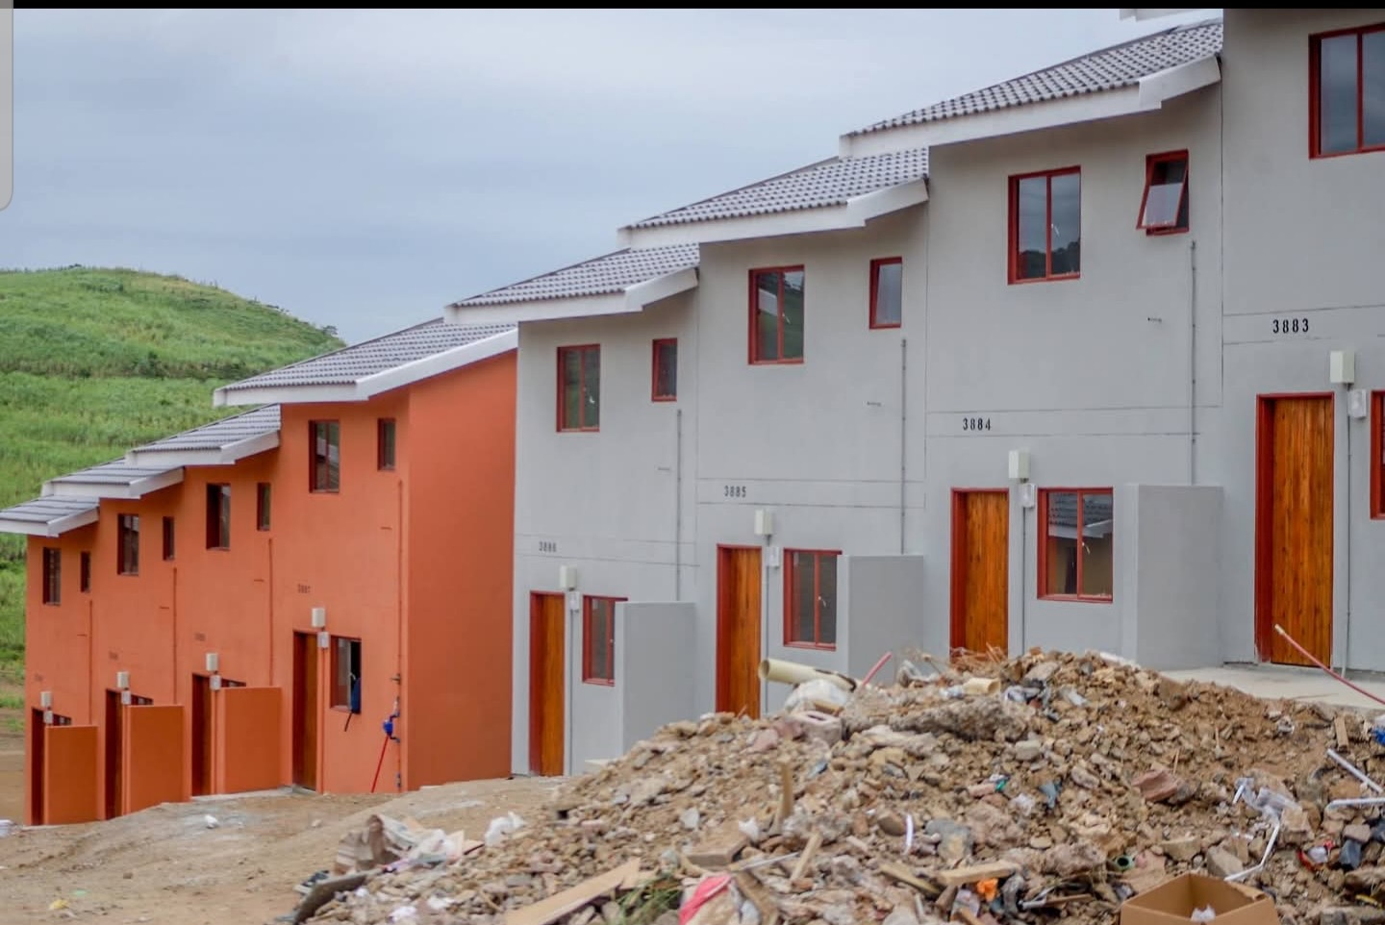
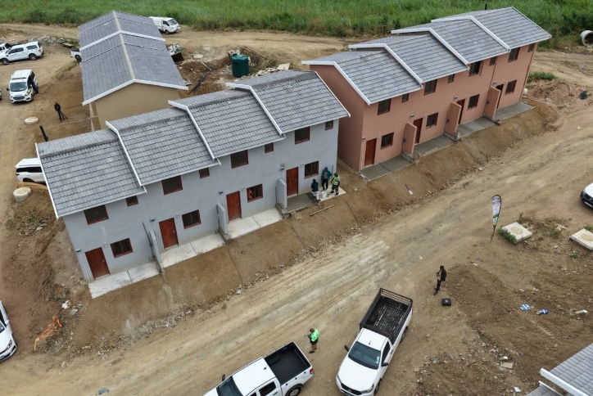
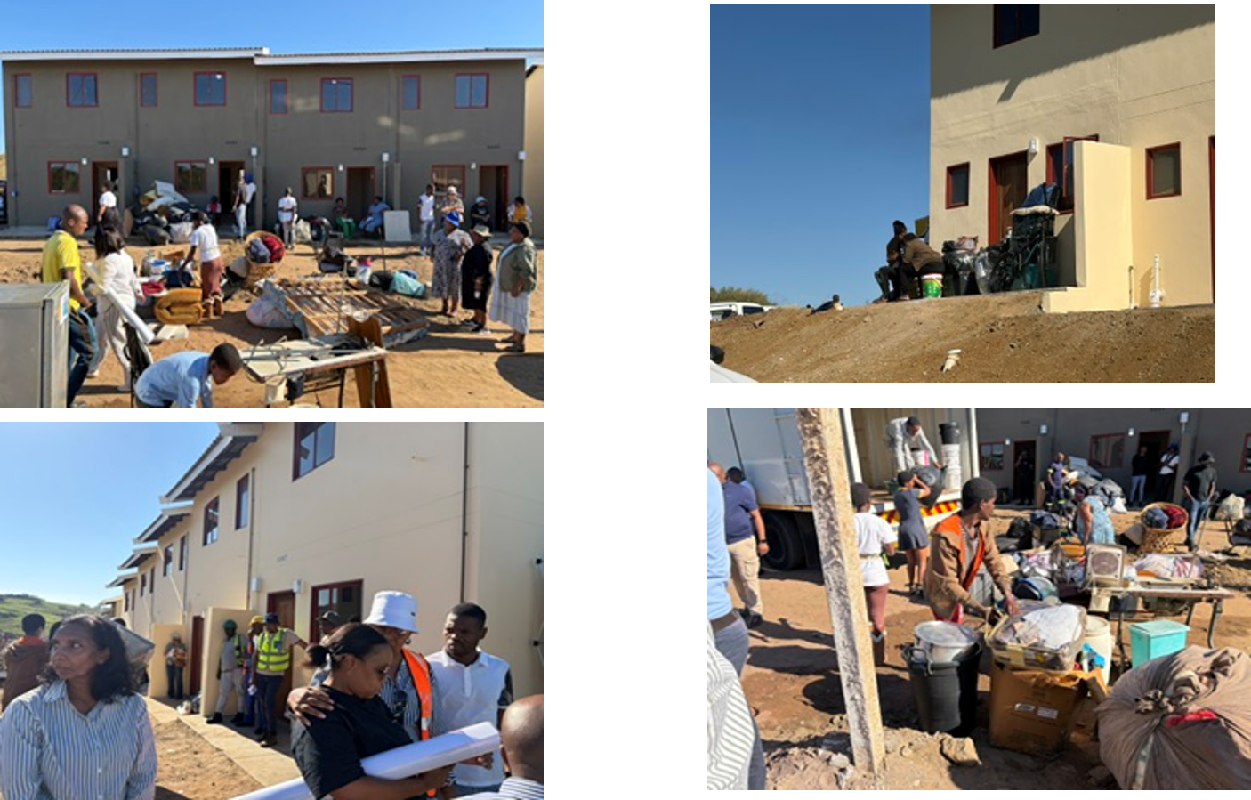
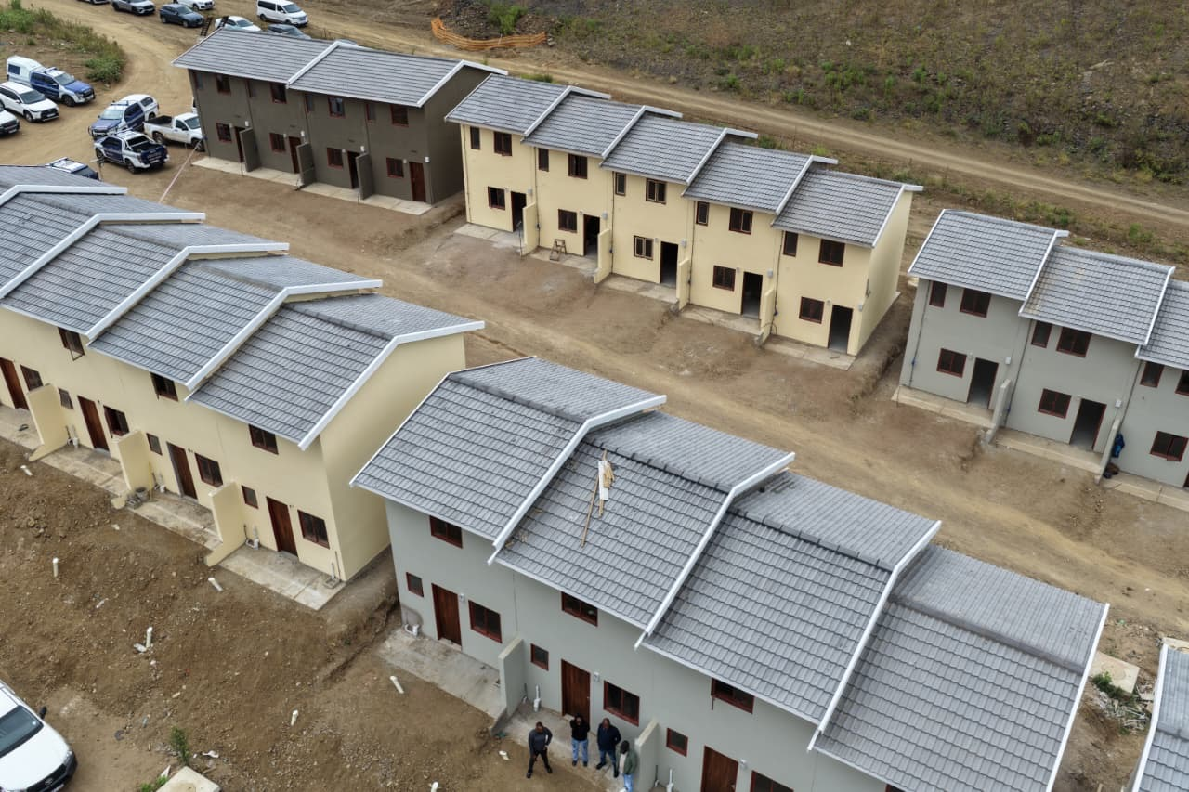
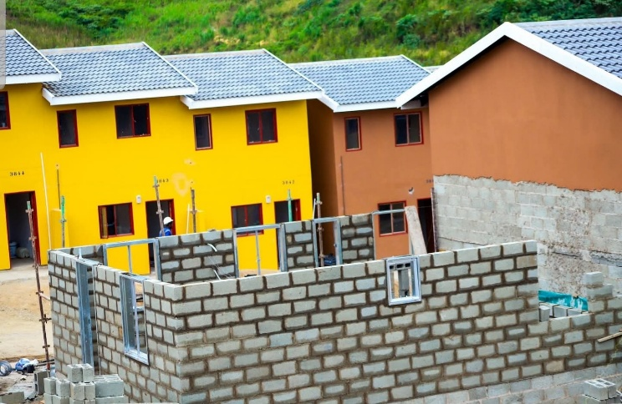

CORNUBIA
CORNUBIA 113 HOUSES PROJECT PROOF OF LIFE
Families Moved In By 22 May 2026

Slide 9

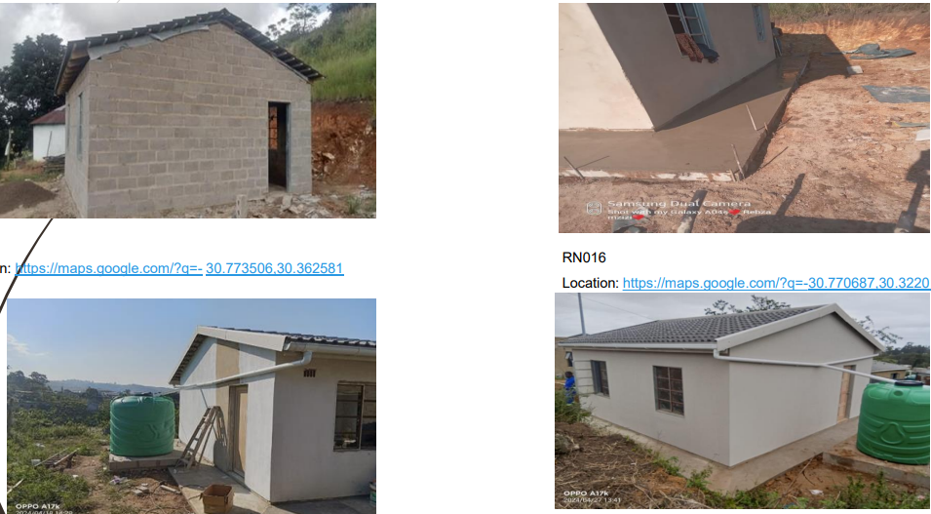
DEVELOPMENT BANK OF SOUTH AFRICA(DBSA)
26 of The Donated 200 houses Completed

Slide 10

Which TEAs Will Close By When?
Detailed timeline and list of remaining flood victims in temporary accommodation, including expected dates for formal housing allocation and prioritization of those longest in temporary units
TEA ADMINISTRATOR | NAME OF SERVICE PROVIDER | NAME OF TEA | NO.OF FAMILIES | NO.OF PERSON IN TEA
ETHEKWINI METROPOLITAN | QALAKAHLE | ZWELIBOMVU | 24 | 85
 | SPHANABANTU | NTUZUMA A, | 67 | 239
 |  | ADAMS ( | 0 | 0
 |  | IFRACOMBE | 0 | 0
 |  | DASSENHOEK | 0 | 0
 | LB LION B INVESTMENTS | 152 O’ FLAHERTY RD,RESERVIOR HILLS | 0 | 0
 | BHUNGANE PROPERTY TRUST | PINETOWN STUDENT VILLAGE | 110 | 427
 | BHUNGANE PROPERTY TRUST | 287 MAHATMA GANDHI ROAD, DURBAN | 0 | 0
HOUSING DEV AGENCY | CONCOST DEVELOPMENT | CHE GUEVARA | 37 | 125
 |  | UMBILO | 9 | 40
 |  | VALLEY VIEW | 0 | 0
 | ASTIA | 120 O’FLAHERTY ROAD, RESERVIOR HILLS | 153 | 475
 | CRYSTAL VALLEY | 120 O’FLAHERTY ROAD, RESERVIOR HILLS | 117 | 246
ITHALA | ASTRA STUDENT ACCOMMODATION HOUSE (PTY) LTD | ASTRA BUILDING | 266 | 518
TOTAL |  |  | 783 | 2484
STATUS
Already Closed | Already Closed Through Relocations to National TEA | To Close By July/August 2026 | To Close By Mid 2027
6 TEAs | 2 TEAs | 1 TEAs | 5 TEAs
In Ethekwini we have already closed Eight (8) TEAs , and another are still remaining. From the remaining seven ,One TEA will close by August 2026 through relocation to Montclair Lodge

Slide 11
MAJOR MILESTONS GOING FORWARD
April 2026 | May 2026 | June 2026 | July 2026
40 % Montclair refurbishment (Phase 1)- KZNDHS - Finish building 113 houses in Cornubia- Metro (Done) | Completion of Montclair Lodge Phase 1 small rooms – 136 units) Metro Allocation of 113 houses Metro Close 152 O’Flaherty TEA KZNDHS Close Dassenhoek TEA KZNDHS (Done) | Close 7 of the – 14 TEAs in eThekwini- KZN DHS (Done) | Contractor for 500 TRU to establish on site in Cornubia. NDDHS- Not Done Allocation of 136 rooms in Montclair Lodge –HDA (Done)
TITLE
August 2026 | September 2026 | October 2026 | December 2026
Work in progress on TRU’s in Cornubia- NDHS Phase 2 Montclair BOQ- KZN DPW 2nd batch houses (60) in Cornubia started –Metro Allocation of Additional 160 rooms in Montclair Lodge –HDA | First group of 200 families relocate from TEAs to Cornubia Duplex TRUs- National DHS – NB this target is at risk as the start did not happen in July 2026 Allocation of 292 rooms in Montclair Lodge Metro | 613 sites in Cornubia serviced- Metro 2nd batch houses (60) in Cornubia complete -Metro | Construction Work In Progress of an additional 146 houses in Cornubia by December 2026- Metro
Inspiring Hope for a Better Future
Umuntu Ngumuntu Ngekhaya

Slide 12
RECOMMENDATIONS
  The HS Committee is hereby recommended to:
    Note progress regarding Permanent Housing for Flood Victims including:
      Montclair Lodge Refurbishment and readiness thereof
      Number of families that have moved to permanent homes thus far
      Closure of Eight (8) of the 14 TEAs in eThekwini
      Detailed timeline and list of remaining flood victims in temporary accommodation, including expected dates for formal housing allocation and prioritization of those longest in temporary units
      Envisaged highlight developments going forward & Identify opportunities for outreach programs
TITLE
Inspiring Hope for a Better Future
Umuntu Ngumuntu Ngekhaya

Slide 13








THANK YOU
Inspiring Hope for a Better Future
Umuntu Ngumuntu Ngekhaya
(031) 336 5300 (dbn)
(033) 392 6400 (pmb)
Inspiring Hope for a Better Future
Umuntu Ngumuntu Ngekhaya
@kzndohs
www.kzndhs.gov.za
Kwazulu-Natal Department of Human Settlements
@kzn.humansettlements
0800 701 701
ANTI-FRAUD E-MAIL:
fraudhotline@kzndhs.gov.za

