Slide 1
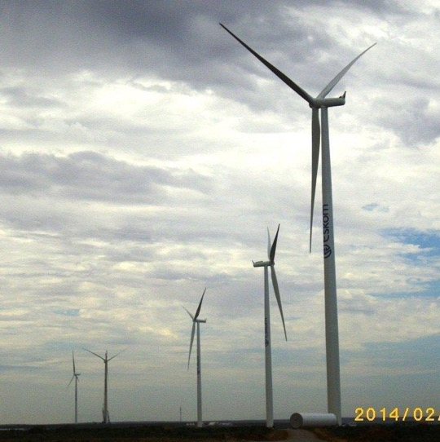
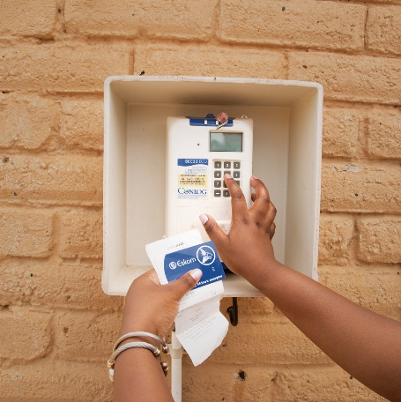
Inxuba Yethemba Local Municipality
Eskom
10 October 2025

Slide 2
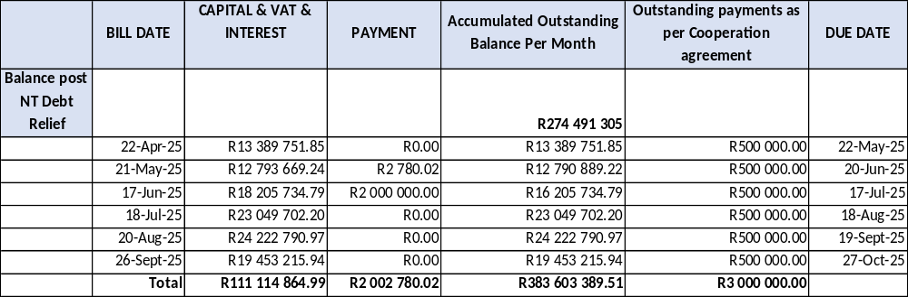
Municipality Debt Status Post Cooperation Agreement
In the Cooperation Agreement the municipality was to pay current accounts on time and an additional R500 000 to be increased to R1m towards the old debt of R274.4m from post Debt Relief approval.
Below table is the status of the debt since the Cooperation Agreement.

Slide 3
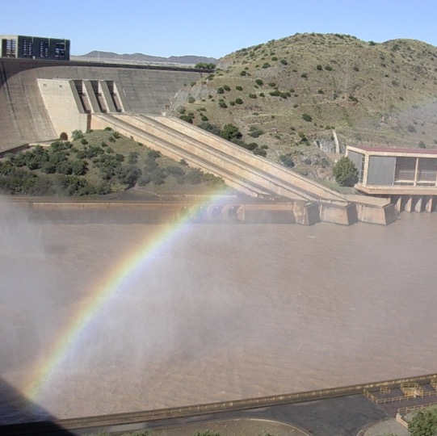

Thank you

